Slide 1
ADVANCED DEGREE ORIENTATION
Welcome!
Hoşgeldiniz أهلا بك 欢迎 خوش آمدید Bienvenidos Bienvenue
स्वागत हे

Slide 2
ADVANCED DEGREE ORIENTATION
Mike Grotewiel, Ph.D.
Associate Dean for Graduate Education
School of Medicine
Virginia Commonwealth University
August 17, 2023

Slide 3
ADVANCED DEGREE ORIENTATION
Resources for graduate students
Immediate action items for all students
Questions and answers
PHD student-specific information
Slides will be distributed

Slide 4
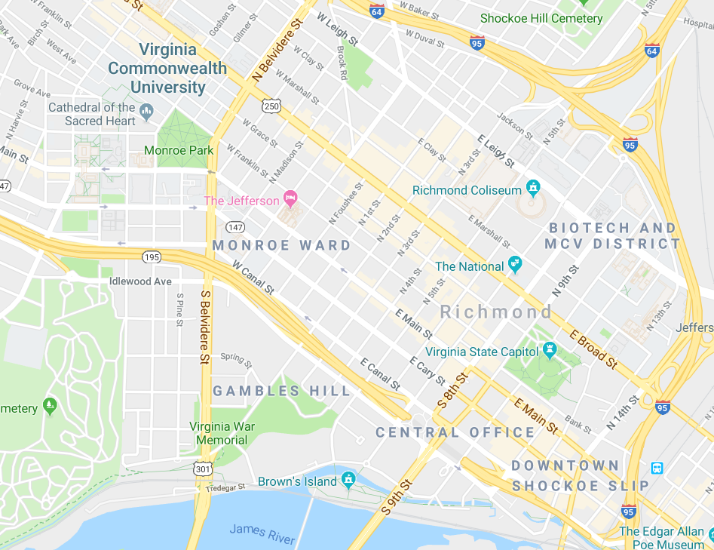
THE CAMPUSES
~1.5 miles (~2.5 km) between two campuses
VCU Parking & Transportation
VCU RamSafe
MCV Campus Escort Service
All students may access resources on both campuses
Use MCV resources whenever possible
MP
MCV

Slide 5
Fall 2023 Key Dates for Lecture Classes
8/22: first day of classes
8/28: add/drop ends
9/4: university closed
10/27: last day to withdraw
11/7: university closed
11/20-11/24: no classes, fall break
12/8: last day of classes
12/11-12/15: final exams
SOM Graduate Student Resources -> Academic and Other Calendars
VCU Academic Calendar https://academiccalendars.vcu.edu/
DIDACTIC COURSES

Slide 6
VCU Offices
GETTING HELP
SOM Graduate Education Office
Program Directors, Mentors, Instructors
~300 SOM Graduate Students

Slide 7
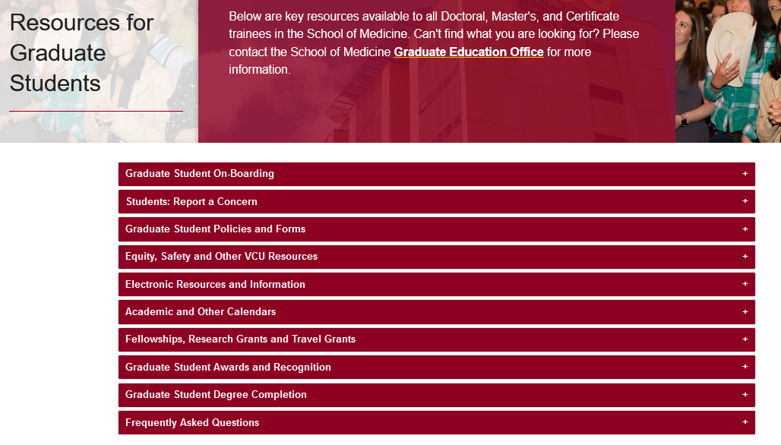
https://medschool.vcu.edu/education/graduate/current-students/
RESOURCES FOR STUDENTS

Slide 8
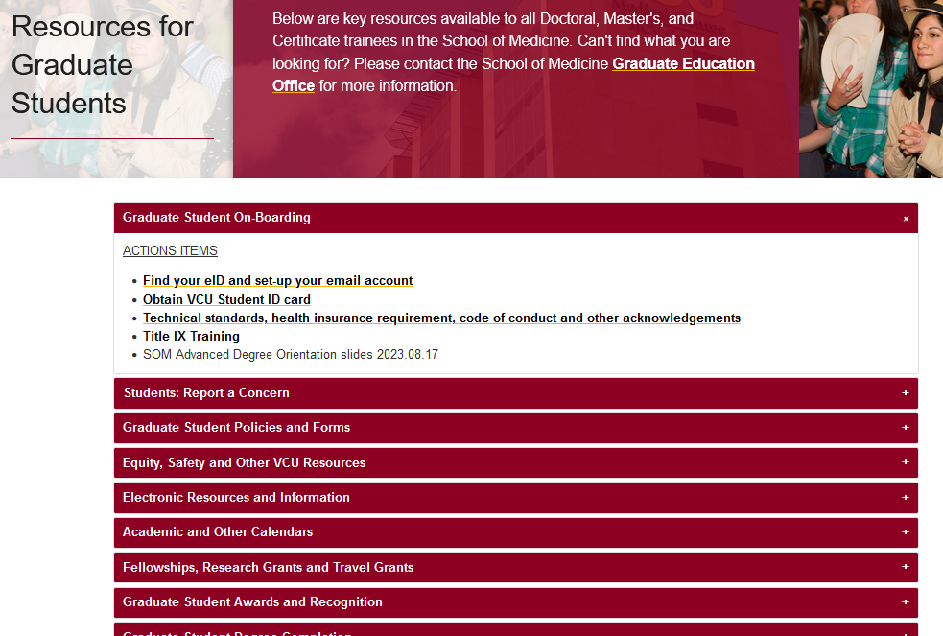
https://medschool.vcu.edu/education/graduate/current-students/
RESOURCES FOR STUDENTS

Slide 9
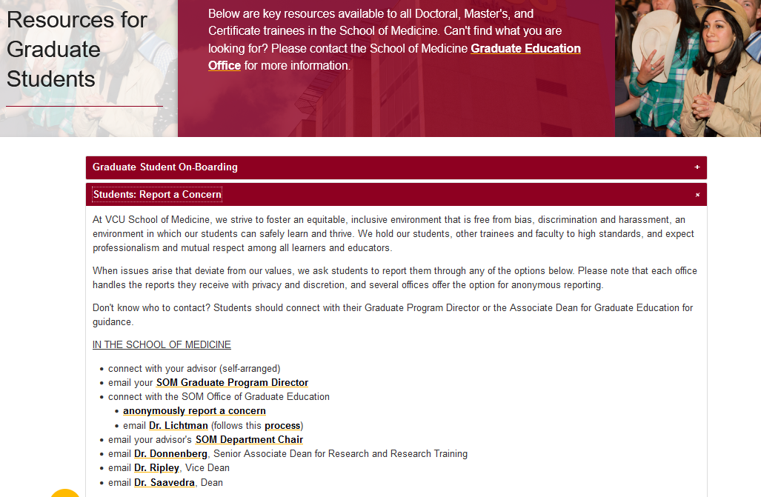
https://medschool.vcu.edu/education/graduate/current-students/
RESOURCES FOR STUDENTS

Slide 10
https://medschool.vcu.edu/education/graduate/current-students/
RESOURCES FOR STUDENTS
Everyone wants you to succeed!
Use the available resources!

Slide 11
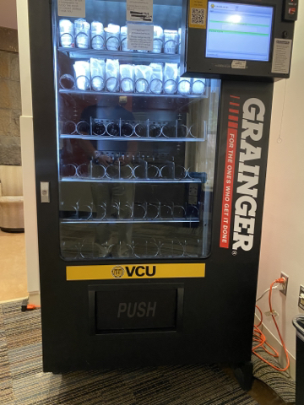
RESOURCES FOR STUDENTS
Face coverings/masks not required, but welcome
Masks and other materials available in vending machines (e.g. Hunton Hall)
COVID vaccination might be required for students in clinics
University Student Health Services
Immunization
Other services

Slide 12
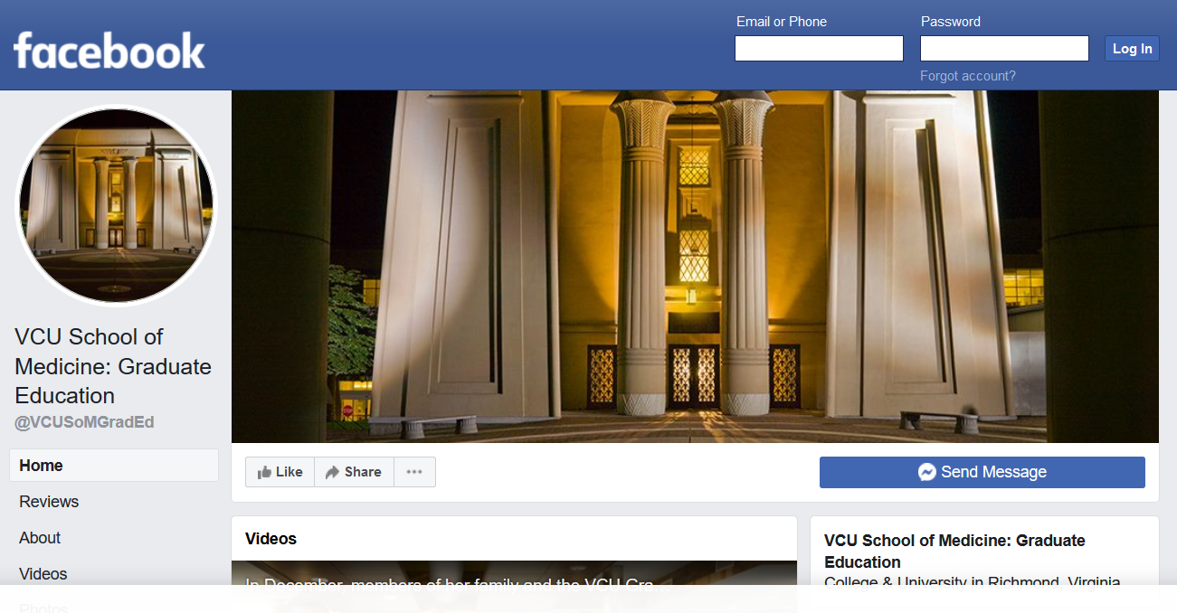
RESOURCES FOR STUDENTS
https://www.facebook.com/VCUSoMGradEd/

Slide 13
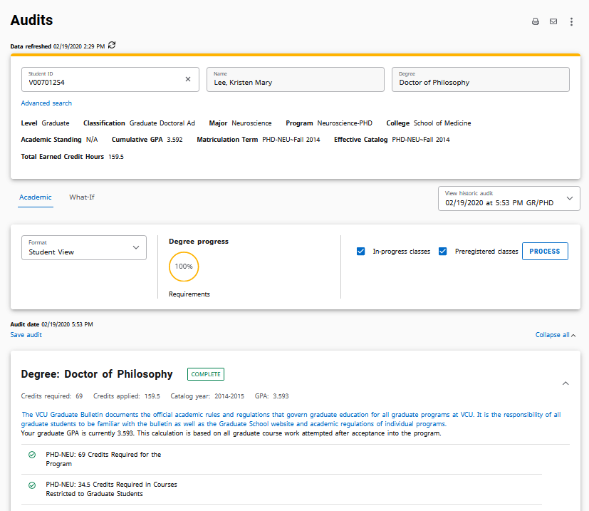
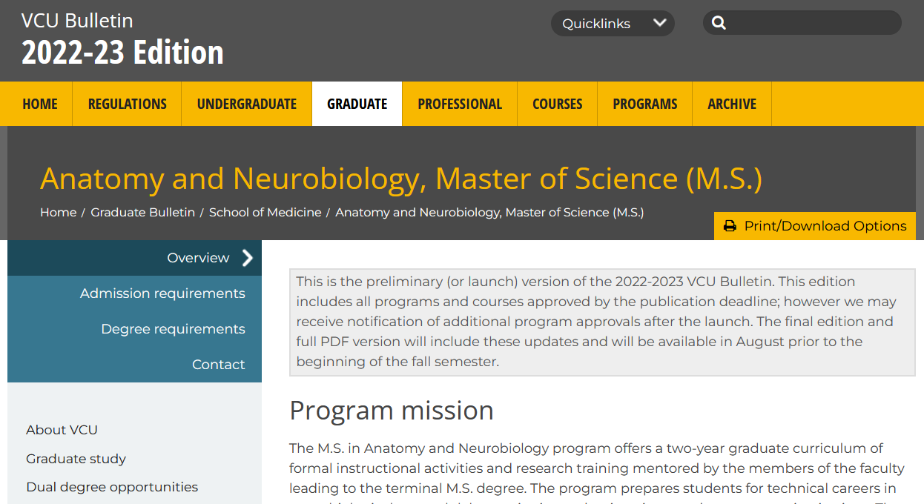
OTHER KEY INFORMATION
email is the official means of communication
DegreeWorks is the official degree audit tool
VCU Bulletin contains official degree requirements

Slide 14
IMMEDIATE ACTION ITEMS
Today or ASAP:
SOM Graduate Student On-Boarding https://medschool.vcu.edu/education/graduate/current-students/
Obtain eID
Set-up email account
Obtain VCU ID
Complete SOM graduate student acknowledgments
Look for and complete Title IX training
Review these slides
Before 8/22: Meet with Program Directors, register for classes
On 8/22: attend classes ☺

Slide 15
Tonya Osmond, EdD, LPC
University Counseling Services
Kevin Harris, PhD
Diversity, Equity and Inclusion
Brandi Daniels, M.Ed
Division for Academic Success
Rocky Carmine
Student Conduct and Academic Integrity
Mike Grotewiel, PhD
Arturo Saavedra, MD, PhD, MBA
Welcome from the SOM Dean
Anita Navarro, EdD, moderator
Student Panel “What to Expect in Graduate School?”

Slide 16
VIRGINIA COMMONWEALTH UNIVERSITY
University Counseling Services
Tonya Osmond, EdD, LPC

Slide 17
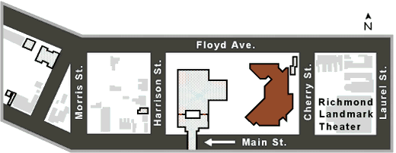
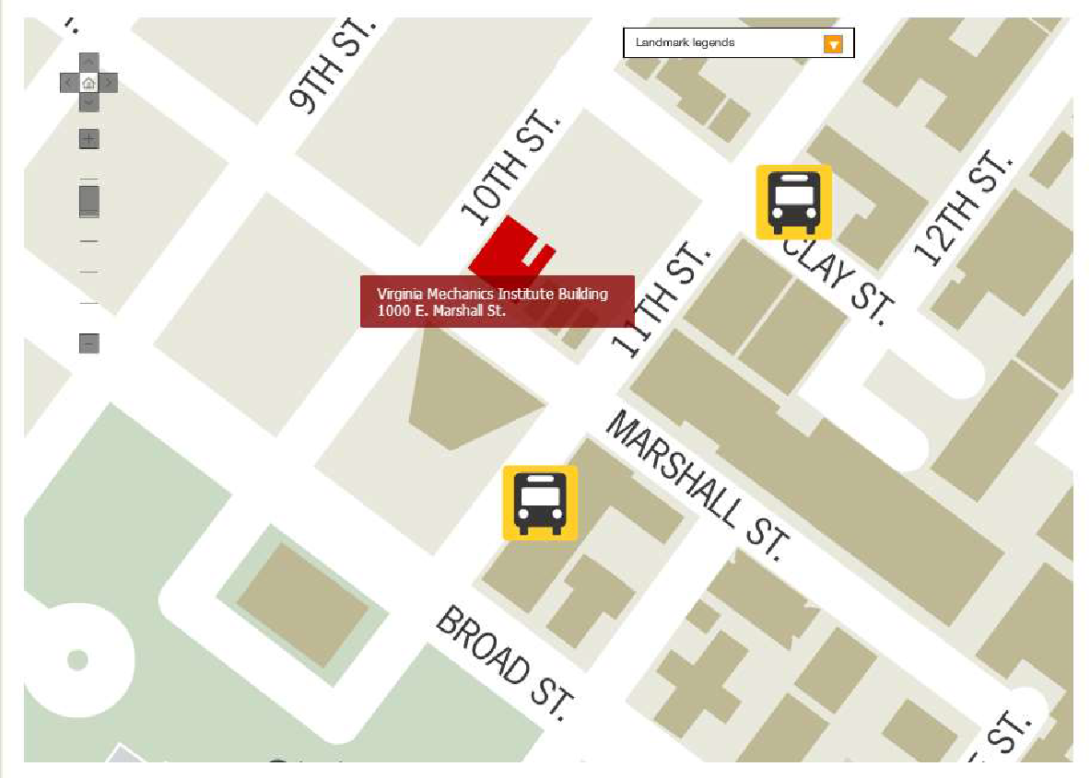
Where are our offices?
Monroe Park Campus
Student Commons – Room 238
907 Floyd Ave.
804-828-6200
M - F 8:00am – 5:00pm
MCV Campus
VMI Building, 4th floor – Room 412
1008 E. Marshall St.
804-828-6200
M & T 11:30am – 8:00pm | W 11:30am-5:00pm
Th - F 8:00am – 5:00pm
Notes:
Talk a bit about what the RAM entails, including the fact that we make a recommendation based on their needs/presenting concerns

Slide 18
UCS Basics
UCS Services are available to enrolled VCU students, and are free of charge
Information disclosed in clinical sessions is confidential

Slide 19
Individual Therapy
Group Therapy
Relationship Therapy
Identity-based Support Groups
Skills Groups
Case Management
Advocacy
Rams in Recovery
24/7/365 Crisis Services
AVAILABLE
SERVICES
Services will be offered both in-person and via Zoom.
Notes:
Provide quick background information about services – touching on Advocacy and RnR

Slide 20
Accessing Services
Students can come to either of our office locations or call our main number at 804-828-6200 to initiate services
Students will be given instructions for completing initial paperwork, and will be scheduled to meet with a UCS clinician for a RAM (Referral and Assessment Meeting)
RAMs are designed to assess student’s mental health needs and to provide information and treatment recommendations

Slide 21
Crisis Services
Drop-in crisis times are available at both locations during the regular 8am-5pm work day
After hours crisis services are available 24/7/365. Students in crisis can call 804-828-6200 to speak to a crisis clinician

Slide 22
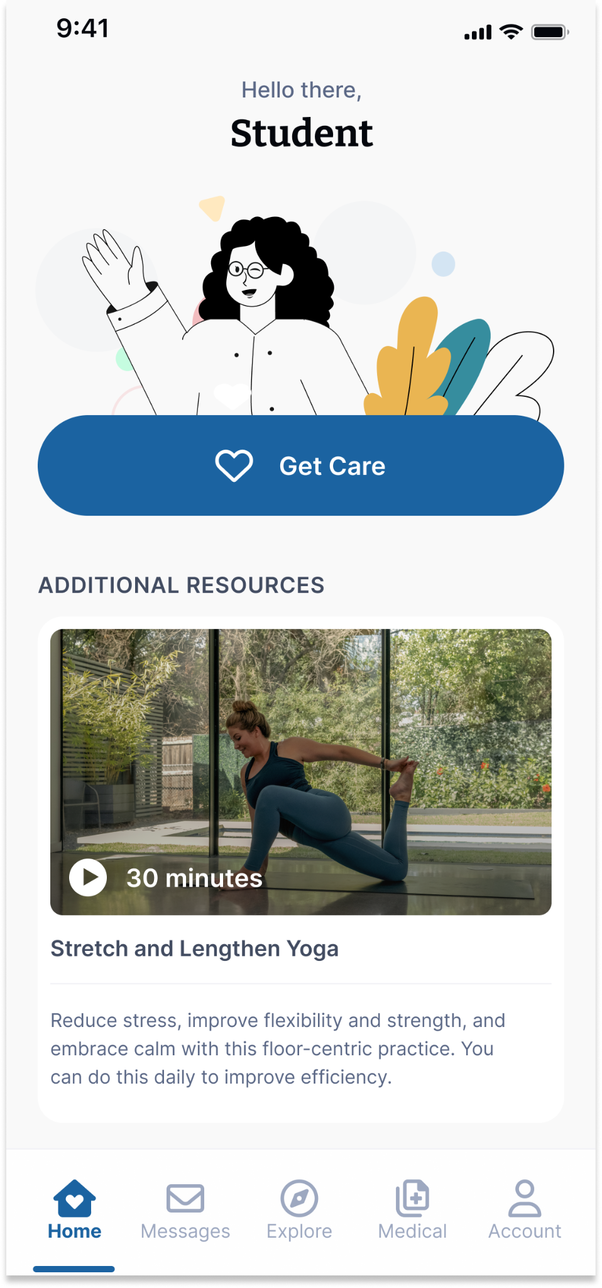
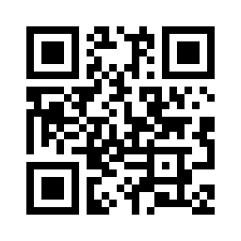
Your Virtual Health and Well-Being Resources
Available on the TimelyCare app or timelycare.com/vcu
Health Coaching
Use this to help develop healthy lifestyle behaviors.
TalkNow
24/7, on-demand emotional support to talk about anything.
Self-Care Content
Visit the “Explore” page for guided self-care content.
Scheduled Counseling
Choose your preferred day, time, and mental health provider.
Scan the QR Code to access care.
@timelycare
QR CODE HERE
It’s for Students.
@timelycare
FOR FREE.
@timely_care

Slide 23
Common concerns addressed
at UCS
Anxiety
Depression
Stress
Trauma
Relationship Problems
Family Issues
Academic Functioning
Adjustment/Life Transitions
Grief/Loss
Cultural/Identity Issues

Slide 24
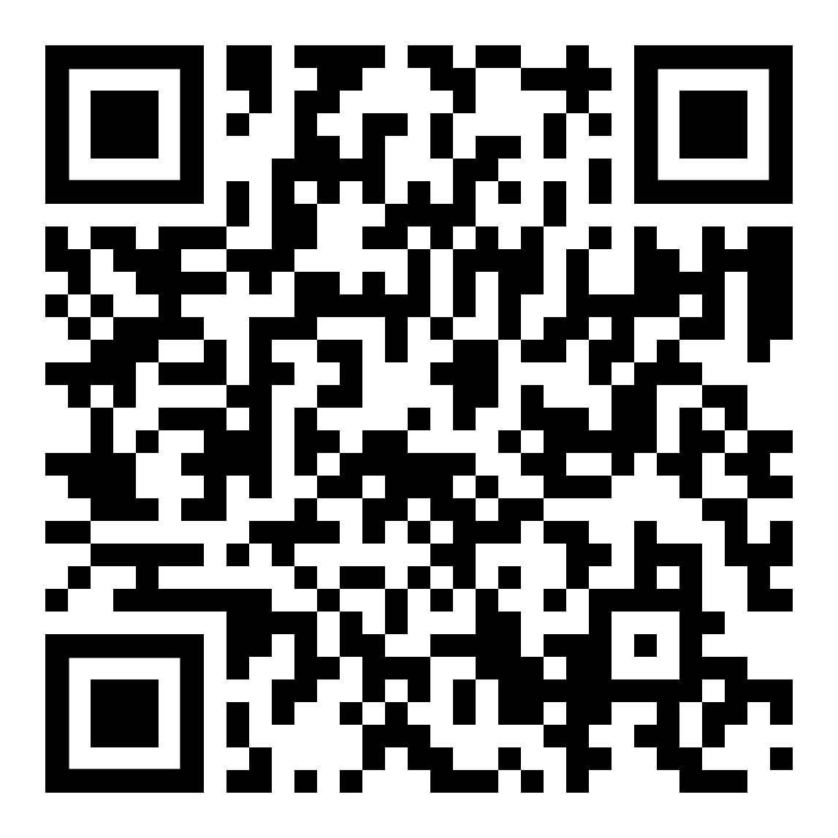
Black Voices
Rainbow Group
Latinx Voices
International Student Discussion
Asian Voices
Survivors of Sexual Violence
Students with Chronic Health Conditions
Grief Support Group
ADHD Support & Skills Group
Support Groups
More info and sign ups here:

Slide 25
Advocacy Services
Rams in Recovery
Non-therapeutic support after
experiencing sexual assault, dating
violence, and/or stalking.
University Student Commons 907 Floyd Ave., Suite 238 (804) 828-6200 myoptions@vcu.edu
M - F: 8:00am – 5:00pm
Structured support for students in recovery from substance use.
The Recovery Clubhouse 1103 W. Marshall St (804) 366-8027 recovery@vcu.edu
T - Th: 10:00am – 5:00pm Drop-ins and Individual Study Spaces

Slide 26
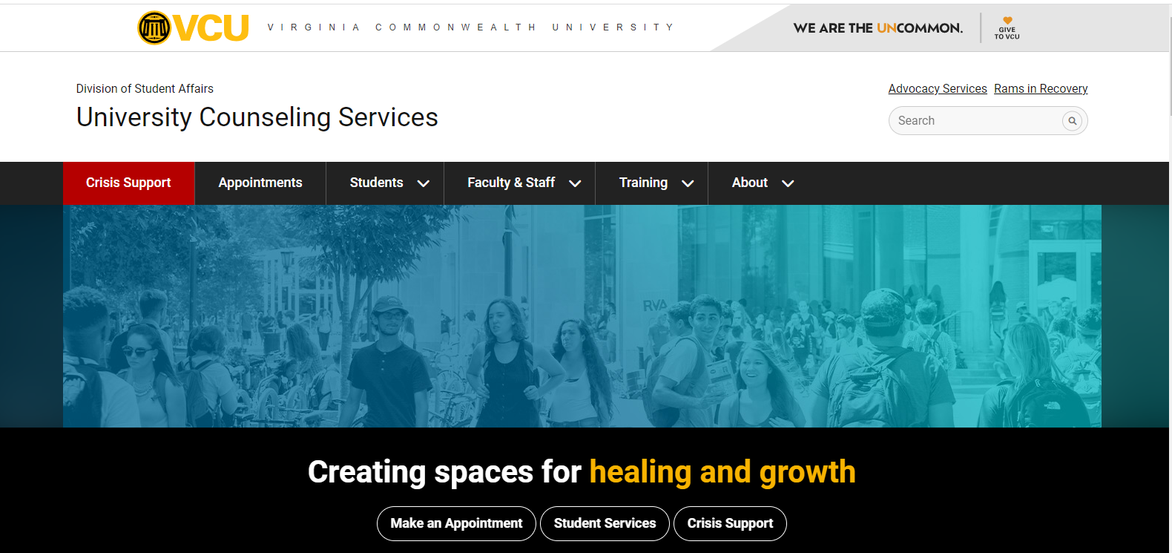
counseling.vcu.edu

Slide 27
Tonya Osmond, EdD, LPC
University Counseling Services
Kevin Harris, PhD
Diversity, Equity and Inclusion
Brandi Daniels, M.Ed
Division for Academic Success
Rocky Carmine
Student Conduct and Academic Integrity
Mike Grotewiel, PhD
Arturo Saavedra, MD, PhD, MBA
Welcome from the SOM Dean
Anita Navarro, EdD, moderator
Student Panel “What to Expect in Graduate School?”

Slide 28
Diversity Imperative: Establishing Diversity, Equity, & Inclusion as Drivers of Excellence
DEI and IC Overview
Notes:
Thank you, Dean Buckley. And, while I am at it, thanks to my colleagues who, in spite of my best efforts, ensured that I had all that I need to prepare for this talk. Jay, Donna, Sha, Amber. I truly appreciate your attention to every detail.
I am honored today to follow our 1st annual lecture delivered by Dr. Geoffrey Young, of the AAMC. Geoff left us with a lot to process In particular, Geoff commended us on our commitment to diversity, particular at the onset of pandemic and to our development of a DEI statement that reflects bold and timely ideals that informs our work ahead. Geoff, also captured the visceral sentiments related to the George Floyd murder and ensuing social unrest.
My hope today is to bookend that wonderful talk from Goeff with an update that clearly indicates we were listening.

Slide 29
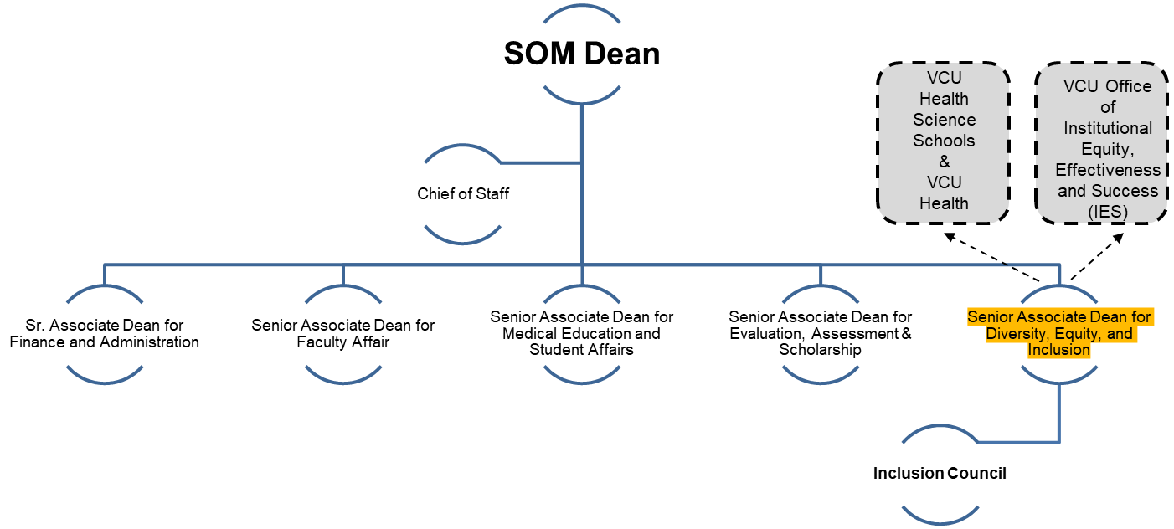
VCU SOM DEI Office
Department DEI Leaders

Slide 30
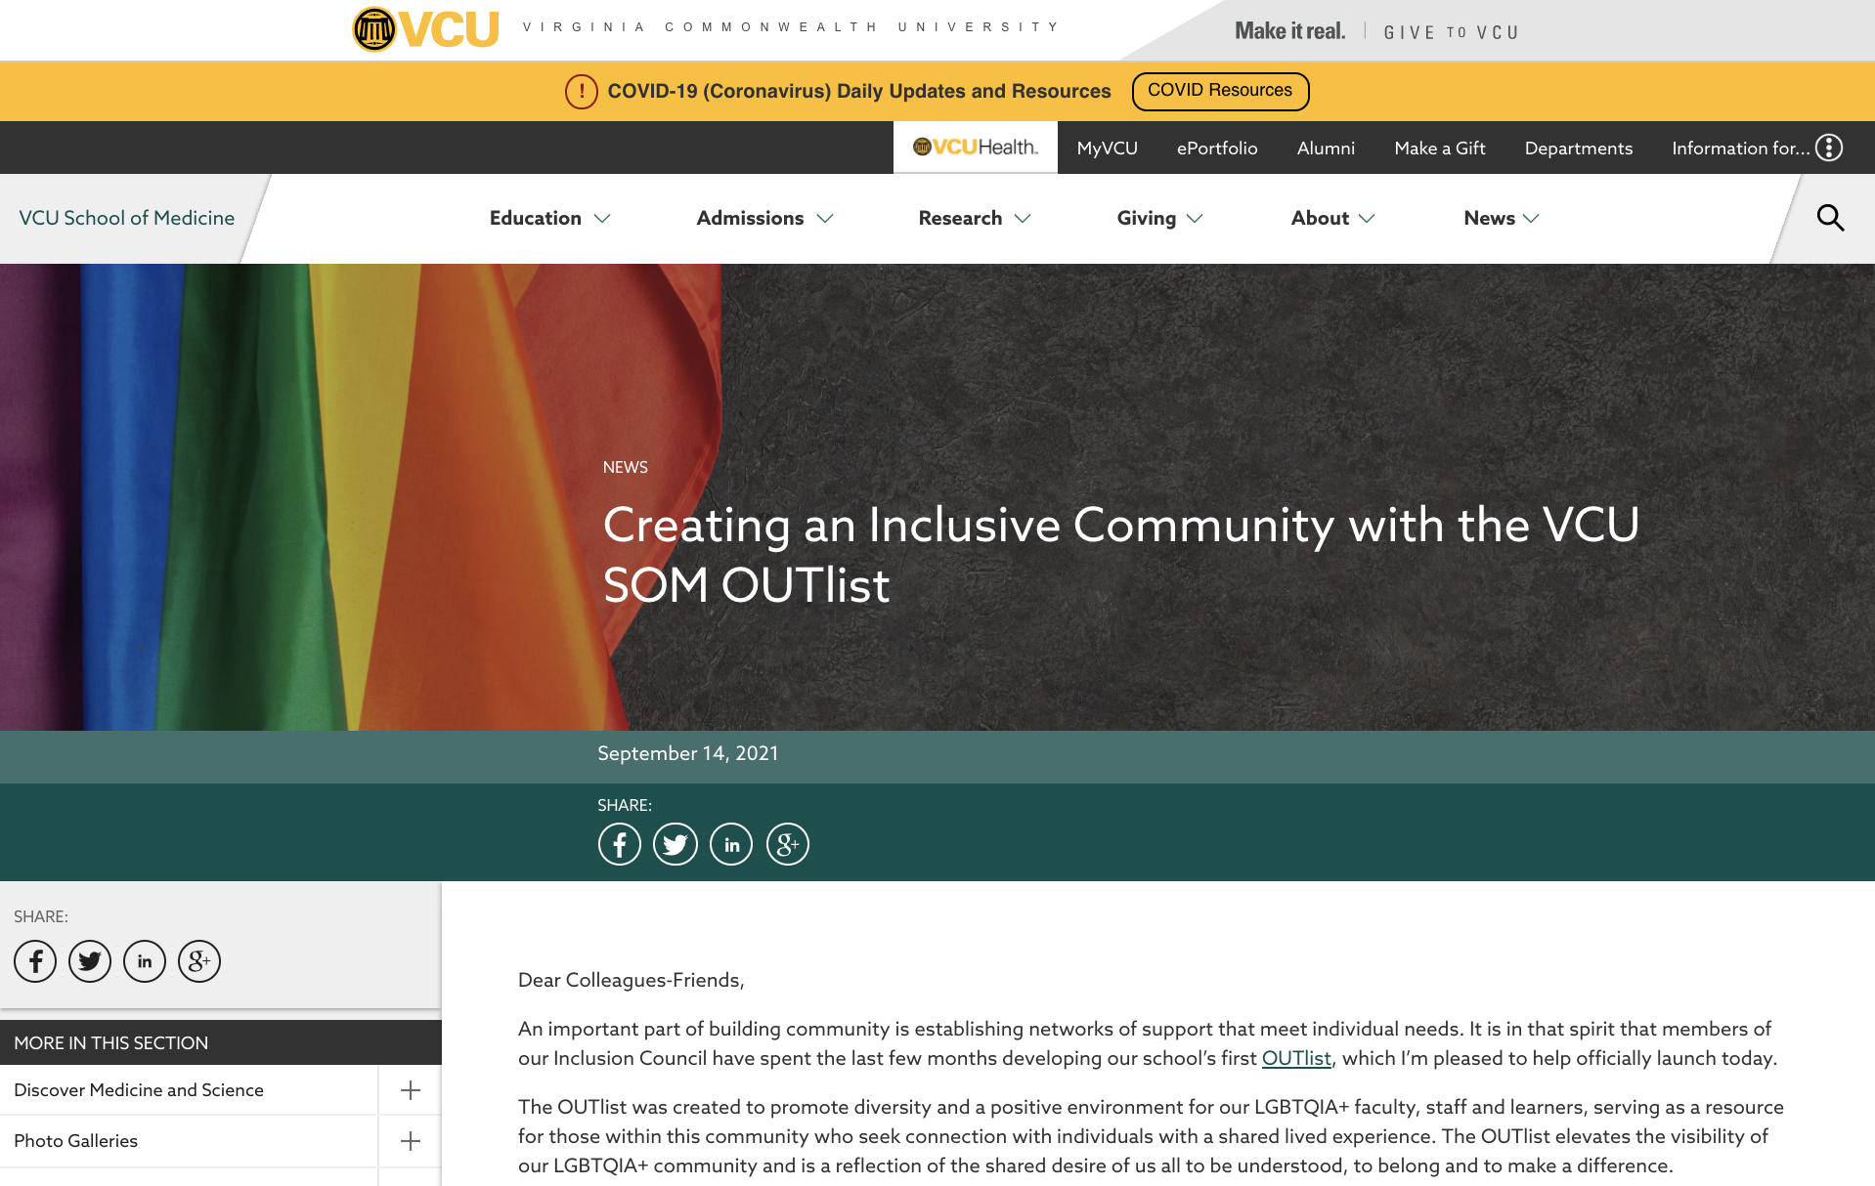
A prospective student who is interviewing very soon reached out after seeing people on the OUTList to talk more about the Richmond and VCUSOM LGBTQ+ community. I knew VCU's stance on inclusion when I chose VCU but for others, I can imagine this can certainly be a fear of deciding where to go to school. Thank you so much for your continued work on increasing visibility and inclusion!!!!
Inclusion
Council
Strategy: Provide an overarching “coordinating structure” for maintaining ongoing synergy and incorporating emerging voices and perspectives.
OUTList @ VCU
VCU SOM M3 Student
Notes:
An important structural component is our IC that is amply chaired by Dr. Bob Findling and Dr. Donna Jackson.
This is not the typical Diversity committee that is limited in its scope and its authority.
The IC is intentionally connected to the Senior Leadership of the School and operates as a bridge between the ideals, aspirations, and even concerns of the SOM community and the leadership, vision, and yes, resources that falls under the purview of our Senior Leaders, and the Dean in particular.
The recent launch of the SOM OUTList is a prime example of how having structure in place to host great ideas whose time has come.
The OUTList, quite frankly, is a tangible expression of our stated DEI values, to create an inclusive work and learning environment for all.
And going further than symbolism, the clear statement that yes, our LGBTQIA+ colleagues and learners are safe, appreciated, and valued.
It heartened me to receive a note from one of our M3 students highlighting the fact that the launch of the OUTList signaled that VCU SOM get’s it and that a potential applicant has given our School a closer look.

Slide 31
SOM Department Leadership
Department
DEI Leader
Dermatology
Emergency Medicine
Family Medicine
Neurology
OB/GYN
Pediatrics
PM&R
Psychiatry
Radiation Oncology
Surgery
Kimberly Salkey, MD
John C. Wiggins, MD
Jennifer Gilbert Hinesley, PhD
Stephanie Bissonnette, DO, MPH
Tashima Lambert Giles, MD
Karen Hendricks-Munoz, MD
Ana Mills, PsyD
Stella Lopez, PsyD
Bridget Quinn, MD, PhD
Rebecca Zee, MD
Department
Goals
DEI Office
Priorities

Slide 32
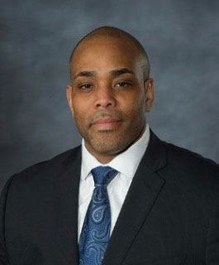
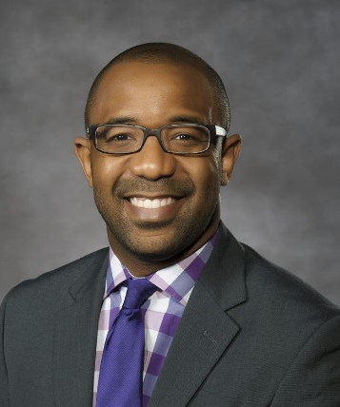
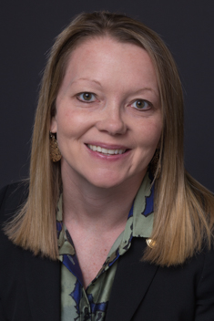
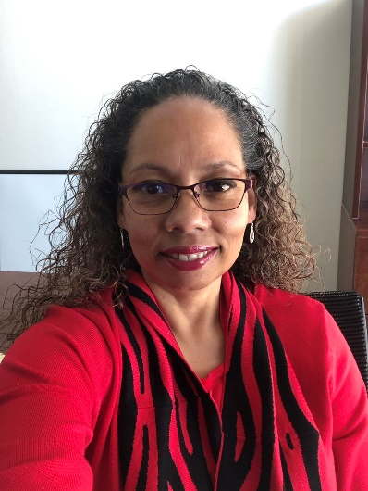
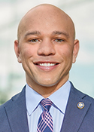
VCU Health | Diversity [Officers] Driving Excellence
"To me, diversity is what makes our academic institutions, healthcare delivery organizations, and communities exciting places to learn and grow. In leadership and management, we know that having diverse teams fosters creativity and innovation and leads to improved organizational performance. From a healthcare delivery perspective, staffing our organizations with clinicians who mirror the communities we serve enhances the likelihood that we effectively relate to our patients and can meet their healthcare needs. I believe diversity is essential everywhere, but in healthcare, it's literally a matter of life or death."
Many people believe diversity refers to or means learning about someone else. However, the most critical starting place and learning regarding diversity in my opinion begins with reflection and introspection. Learning about and with different people has taught me a lot about myself. This process has strengthened my understanding and relationship with people from all backgrounds.
Diversity for me is about two things: one, ethics - because every action, every hire, every patient encounter should have at its core the carrying out of our social contract with the public, a public that includes all; and two, inquiry, particularly inclusive inquiry - what questions are we asking, of whom, on behalf of whom, and to achieve what outcomes? Diversity, grounded in ethics and inquiry, will foster the inclusive belonging, both individually and organizationally, we ought continually strive for!
Massey
Dentistry
Diversity offers opportunities to learn, grow, join, and support; to see beyond ourselves and to understand the perspective, experience, and feelings of others.
Dr. Carlos Smith
Tremayne Robertson
Pharmacy
Diversity is an innate aspect of our human experience. In other words, all of us add to the tapestry of humanity. Diversity is also a verb as it warrants an active engagement of our mental, intellectual, emotional, spiritual, and even physical selves in the pursuit of ensuring all of us feel we matter, we belong!
Dr. Victoria (Tori) Keel
CHP & Nursing
Medicine
Diversity, in all its splendor, can separate us, if it is left to exist in a silo. However, diversity can unify us, but it must be grounded in equity and coupled with intentional inclusion, to create a workplace where everyone feels psychologically safe to contribute and grow.
VCUHS
Dr. Kevin Harris
Dr. Marcelle Davis
Dr. Stephan Davis
Notes:
Here’s our team helping to manifest the One VCU Ideal
Level of expertise at work and having early impact
Also, highlight the new DEI officers as a key part of the organizational change and investment in DEI
Discuss what this means, why having these folks here adds material value
What are some of the outcomes that have occurred both explicit and those issues that have been averted
To get there, need to have ongoing and open conversations regarding

Slide 33
Diversity, Equity and Inclusion Statement
We reaffirm the core values of human dignity and of mutual, unconditional respect, and we acknowledge our responsibility to condemn racism and all forms of discrimination.
As educators and mentors, we must support all our learners in achieving their professional goals, regardless of background, culture or socioeconomic status, modeling the care and concern that is so needed in our fractured society.
As researchers, we need to diversify our scientific endeavors to ensure that research benefits those who have historically not seen these benefits in order to improve our ability to deliver precision care to all populations.
As clinicians, we must be committed to care for all who pass through our doors with dignity, compassion and the best that medicine has to offer.
As learners, we should understand the cause and effect of these events and their impact on the lives of those in our community and nation as the next generation of physicians and scientists. We also should be vigilant in our pursuit of knowledge so that we may mobilize it to determine solutions to present day and future problems in society and health.
As colleagues and peers, we must ensure that every member of our SOM community is respected and valued for who they are and for the qualities they bring to our education, research and patient care endeavors every day.
We continuously strive for our workplace and learning environment to reflect the demographic and social milieu of the communities we serve, to advocate for these principles beyond our walls and to be a place of dignity, professionalism, mutual respect and inclusivity.
Notes:
What do we mean by Diversity, Equity, and Inclusion in SOM

Slide 34
DEI in Advancing SOM Mission
Departmental Leaders to Scale Up DEI Initiatives Partners
Integrate / Operationalize DEI Principles in the SOM Strategic Plan and Dean Priorities
Partner with Student Organizations and Student Interest Groups
Stepping in 4 Respect Bystander/Upstander Training
Safe Zone Training
Heritage / Affinity Month Communications & Events
Increasing Staff Visibility, Recognition, & Sense of Belonging
Implement DEI Initiatives Identified in the Graduate Student Survey
Implement Curriculum Transformation through a DEI lens
Launched a Maternal Health Inequities curriculum module/resources
Notes:
I want to switch gears at this point to focus on where this work leads us and, certainly, where our collective commitment is necessary.
Over the coming year, based on conversations with many of you, we will continue to focus attention on building out our systems and sustaining structures., assessing and utilizing culture and climate feedback to ultimately shape the type and scope of programmatic solutions.
Briefly go through each one.

Slide 35
Notes:
While we retain that image of a rich tapestry of identities that make up this audience, I want to further extend the image to how our individual identities work to find a home in our social context.
And, the question I would ask us to think about is which of those elements of who we are, is negotiable, unimportant, unnecessary?
I ask because it’s been my experience that when given “permission” to be open and authentic we see ourselves in our full humanity.
However, our conceptions and operational definitions of race and diversity many ways force us to have that conversation, particularly in our American experience.
And, I submit that our recasting of these concepts is essential to advancing our efforts to be an inclusive work and learning environment.

Slide 36
Diversity "Just is”
Diversity Fallacies
We need “diverse” faculty / staff / students.
I don’t have the “right” lived experience.
I don’t feel prepared or comfortable with discussing issues of diversity.
I am not diverse!
That’s a DEI issue.
Notes:
I want to couch the discussion of diversity and race as things that we know, but have functioned as a society and as individuals as if we don’t know.
If I can get out on the edge a bit, I’d say this discussion is debunking the real BIG LIE!
The first issue is our coming to the understanding that diversity is an innate quality, not manufactured, not synthetic – JUST IS.
I like how Neil deGrasse Tyson puts it – read the quote.
If frame the innate nature of diversity as not having a null set, in other words, there is no situation, particularly in human interactions that is void of fundamental issues of diversity – engagement, power dynamics, navigating our identities, etc.
From a practical sense, repositioning diversity to its proper state begins to mitigate some of the ideas too many operate off that in effect creates barriers to our harnessing the benefits of diversity. I called these Diversity Fallacies.
For example, read them off…
I see this shift in our views of diversity as integral to our success in having diversity truly drive our excellence as it gives permission, if you will, for each of us to find our place within the diversity project.

Slide 37
Diversity, Equity, Inclusion, Accessibility: NIH Framework
People-Centered
Mission NIH will embrace, strengthen, and integrate diversity, equity, inclusion, and accessibility (DEIA) across all NIH activities in service of the NIH mission.
Vision NIH will be a people-centered organization, where the workforce and research priorities reflect our nation’s diversity and all people feel a sense of belonging as they advance the NIH mission.
“Developing a sense of belonging where graduate students feel accepted, valued, and included is a critical factor supporting their wellbeing and influences retention in academia”.
Sources:
- NIH-Wide Strategic Plan for Diversity, Equity, Inclusion, and Accessibility (DEIA) | National Institutes of Health (NIH)
- Creating a Sense of Belonging: Resources for Research Faculty Mentors | BCM
Notes:
Patients described what an exceptional doctor is in their own words
Past med school commencement speaker stated, if you would listen to the patient, they will give you the diagnosis!

Slide 38
Notes:
I will end where I began
The Word Cloud that came out of our opening menti poll revealed the rich diversity that crosses multiple dimensions and that speaks to our ability to bring significant talent to bear.
We have a chance to do something big in terms of providing our local and external communities with tangible, meaningful change, progress.
As Dr. Robert Winn famously says, let’s quit playing.
Our work over the past 18 months, if nothing else, has unleashed a previously dormant capacity to challenge racism and other forms of discrimination, foster a sense of belonging for all who seek it, and to sustain our excellence, in fact, amplify it event farther.
This is not just talk colleagues, friend. Diversity as a driver of our collective excellence – This is US!

Slide 39
Tonya Osmond, EdD, LPC
University Counseling Services
Kevin Harris, PhD
Diversity, Equity and Inclusion
Brandi Daniels, M.Ed
Division for Academic Success
Rocky Carmine
Student Conduct and Academic Integrity
Mike Grotewiel, PhD
Arturo Saavedra, MD, PhD, MBA
Welcome from the SOM Dean
Anita Navarro, EdD, moderator
Student Panel “What to Expect in Graduate School?”

Slide 40
VMI Building, 2nd Floor(Suite 231)
Debbie Roberts
Brandi Daniels

Slide 41
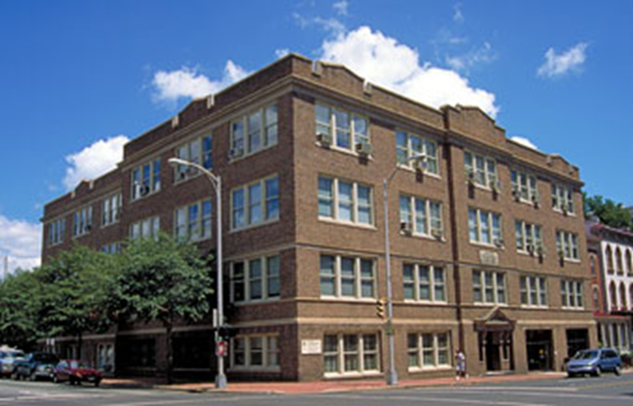
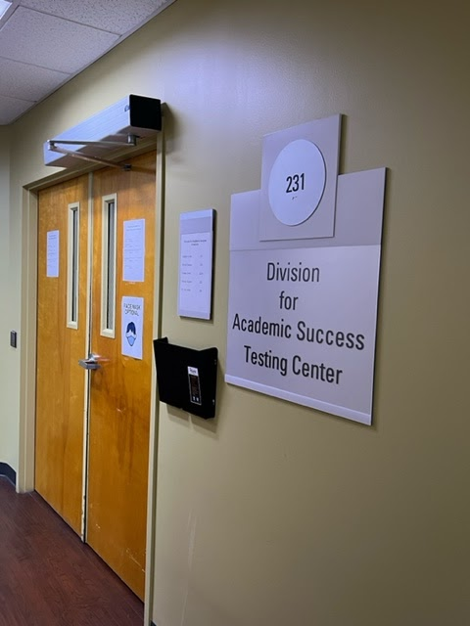
Division of Academic Success
The Division for Academic Success (DAS) offers disability and academic support services to students in the VCU Health Sciences schools.

Slide 42
What is Considered a Disability?
A physical or mental impairment that substantially limits a major life activity (ie. talking, seeing, hearing, learning, etc).
This includes concerns that are:
Temporary (ex. TBI and Broken Limbs) and
Long-Term/Lifetime (ex. Cancer, Hearing Loss, and Mental Health)

Slide 43
Academic Accommodations
A student with an ADA qualifying disability or condition has the right to request reasonable academic accommodations.
Accommodations are granted to students who have a documented disability
Accommodations allow students access to demonstrate their knowledge of the content of the curriculum
Accommodations do not compromise the technical standards of the program

Slide 44
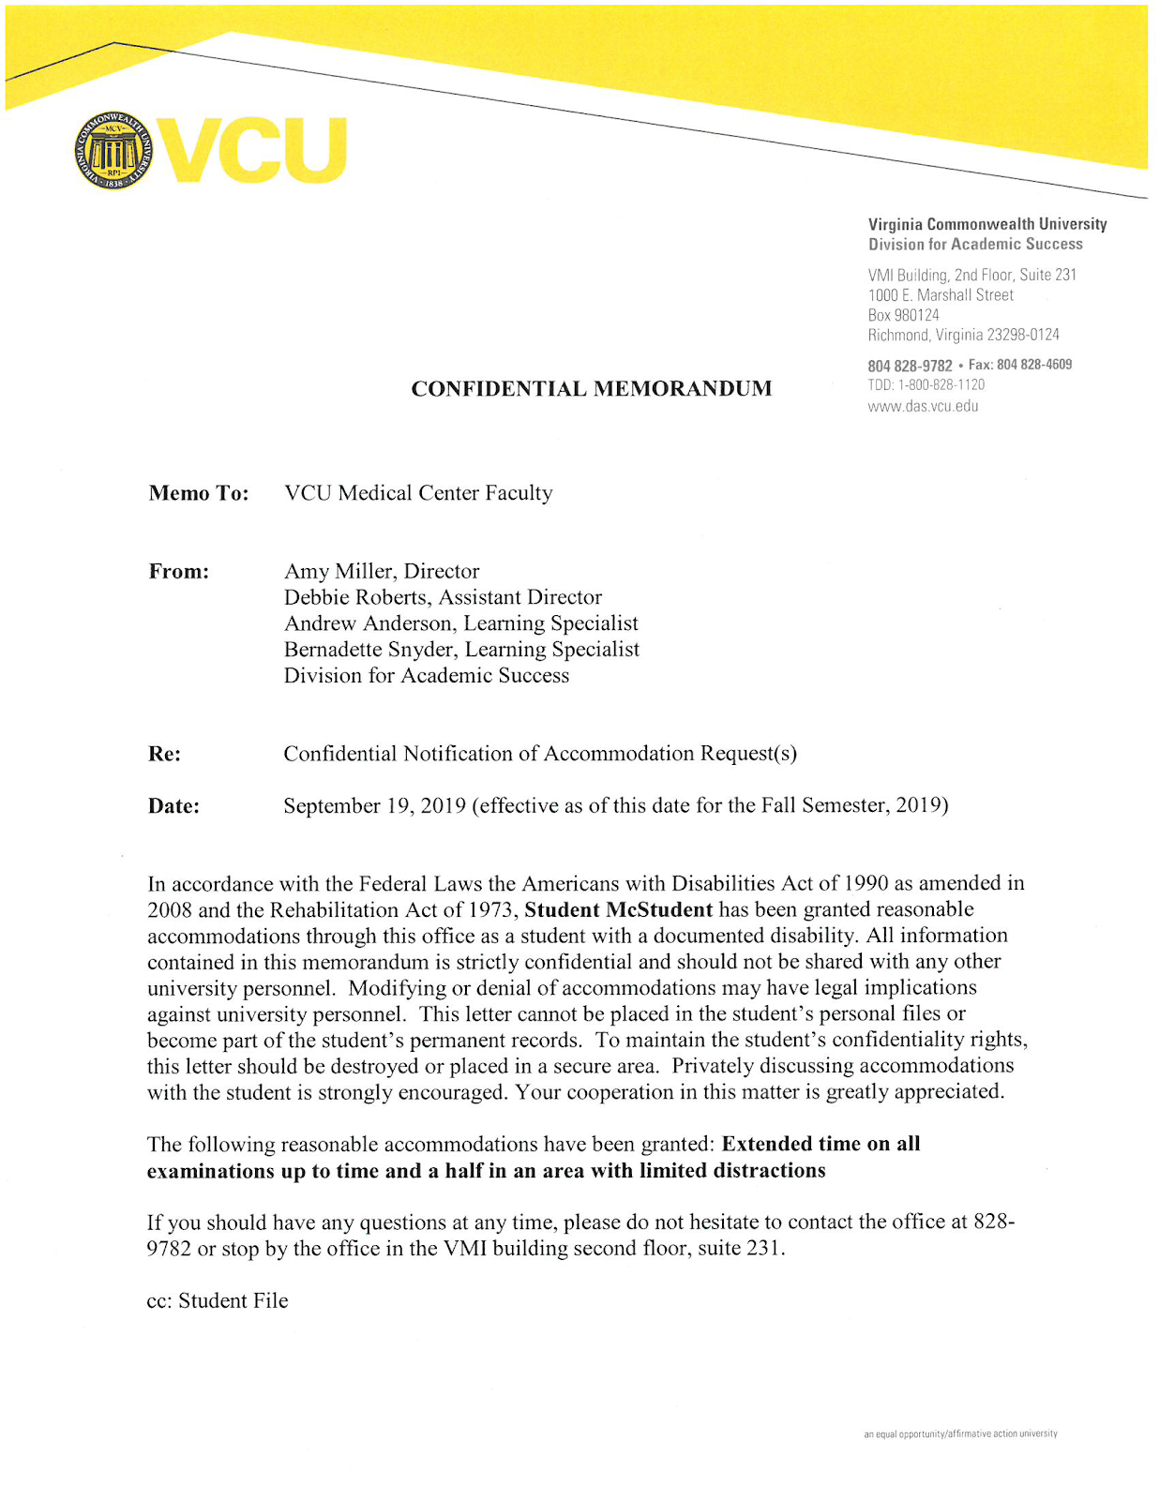
What’s the process?
Complete the online intake form: https://das.vcu.edu/
Meet with an Academic Counselor
Provide medical documentation from your service provider
Accommodation letters provided for you to give to your professors
Sample

Slide 45
What do I need to remember?
Academic accommodations are not retroactive– start the process early
Academic accommodations do not alter or change the technical standards Accommodations are set up each semester and reviewed case by case.
All disclosed information concerning a disability is kept confidential and not part of your official VCU record.

Slide 46
Academic Support Services (available for every student)
Study Skills
Exam/Test-taking Skills
Note-taking Skills
Time Management Strategies
MBTI
Learning Connection Inventory

Slide 47
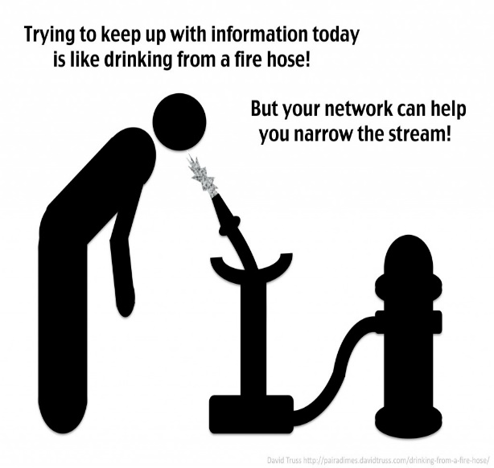
Why does this feel like I’m drinking from a FIRE-HOSE? --APRIL APEERSON, MS UCSD SOM
Why should I change my study Strategies?
Active Learning:
Big Picture
Rough Draft
Organized Summaries
Memorization
Exam Questions
Where do I find time for all of this?

Slide 48
My current Study Strategy?
Does it work?
Are you receiving the grades you want?
Are you happy with your work-flow?
Are you prepared to shift VOLUME-FLOW?
The amount of information you receive per hour/per day may look different from previous programs/courses
How can you be more Efficient?
The best use of your time requires Active, not passive learning
What habits do you need to change?

Slide 49
Active Learning
Identifying- the important information
Organizing- start with the Big Picture
Memorizing- requires frequent review
Applying- the information to more complex situations

Slide 50
Let Me Learn Theory

Slide 51
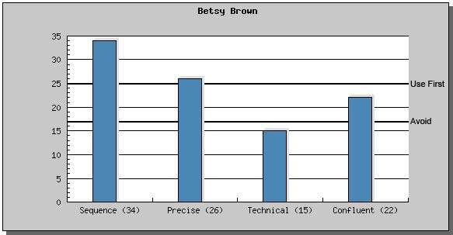
The Learning Connections Inventory©
25-35 = “Use First”
18-24 = “Use As-Needed”
7-17 = “Avoid”
Notes:
Academic Support Services: tutoring, time management, study skills, test taking skills, and note taking skills.

Slide 52
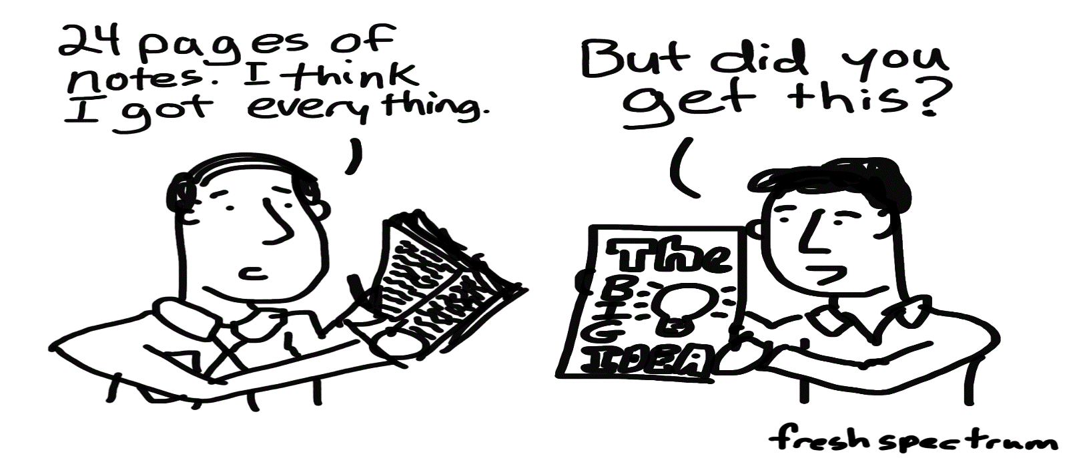
Structure your thinking about
how to tackle the task,
when to use a specific strategy and
why using that particular strategy is effective.

Slide 53
Action Plan

Slide 54
Division for Academic Success
1000 E. Marshall St. (VMI Building)
Suite 231
das.vcu.edu
acadsuccess@vcu.edu

Slide 55
Tonya Osmond, EdD, LPC
University Counseling Services
Kevin Harris, PhD
Diversity, Equity and Inclusion
Brandi Daniels, M.Ed
Division for Academic Success
Rocky Carmine
Student Conduct and Academic Integrity
Mike Grotewiel, PhD
Arturo Saavedra, MD, PhD, MBA
Welcome from the SOM Dean
Anita Navarro, EdD, moderator
Student Panel “What to Expect in Graduate School?”

Slide 56
Student Conduct & Academic Integrity
Rocky Carmine, Assistant Director for Strategic Partnerships & Outreach
Student Conduct & Academic Integrity
2023-2024 Academic Year

Slide 57
VCU Honor System
Academic honesty, truth, and integrity are very important to advancing knowledge and promoting student success.
All students must conduct themselves according to the highest standards of academic integrity

Slide 58
VCU Honor System & Standards of Academic Conduct
Cheating
Deception
Exploitation
Facilitation
Plagiarism
Sabotage
Stealing

Slide 59
VCU Honor System
Unauthorized Collaboration
Plagiarism
Recycling Work
Sharing Academic Materials
“Contract Cheating”

Slide 60
What You Can Do
Make sure you are aware of the expectations of each assignment
Do not share your works with other or upload to websites
Speak with your faculty member if you are ever unsure
Utilize campus resources

Slide 61
Process
Professor reports suspicion of an honor violation to SCAI
If the professor and the student agree, the professor can adjudicate themselves
Otherwise, students are contacted by SCAI and given the opportunity to respond to the allegation and present evidence
“Clear & Convincing Evidence”
If found responsible, a sanction is proposed
A student can appeal if they disagree with the sanction, or responsibility

Slide 62
Sanctions
Class A Sanctions
A Grade of 0 on the assignment
A grade reduction on the assignment
A new opportunity to complete the assignment
Class B Sanctions
A Grade of F in the Course
Suspension
Expulsion

Slide 63
Other Potential Actions
Being found responsible for an Honor infraction may result in
A loss of Assistantship
Lower GPA
Dismissal from the program
Professional Ethics & Integrity
Athletics
Honors College

Slide 64
Honor Pledge:
“On my honor, I have neither given nor received aid on this assignment, and I pledge I am in compliance with the Honor System.”

Slide 65
VCU Student Code of Conduct
VCU Student’s behavior, both on and off campus, is a reflection of the VCU Community
Students are encouraged to engage in responsible social conduct that reflects credit upon the university
If you are breaking the law, it is likely you are also violating the VCU Student Code of Conduct

Slide 67
Become familiar with the policy:
scai.vcu.edu
Rocky Carmine
carminero@vcu.edu
Assistant Director, Strategic Partnerships & Outreach
Student Conduct & Academic Integrity

Slide 68
Tonya Osmond, EdD, LPC
University Counseling Services
Kevin Harris, PhD
Diversity, Equity and Inclusion
Brandi Daniels, M.Ed
Division for Academic Success
Rocky Carmine
Student Conduct and Academic Integrity
Mike Grotewiel, PhD
Arturo Saavedra, MD, PhD, MBA
Welcome from the SOM Dean
Anita Navarro, EdD, moderator
Student Panel “What to Expect in Graduate School?”

Slide 69
QUESTIONS AND ANSWERS
Only 3 answers!
Contact my program director
or course director!
Very, very important!
YES!

Slide 70
QUESTIONS AND ANSWERS
You are confused about course registration. What should you do?
How important is that?
Will they help you?
Contact my program director
or course director!
Very, very important!
YES!

Slide 71
QUESTIONS AND ANSWERS
You did not do well on an assignment. What should you do?
How important is that?
Will they help you?
Contact my program director
or course director!
Very, very important!
YES!

Slide 72
QUESTIONS AND ANSWERS
You will need to miss an assignment. What should you do?
How important is that?
Will they help you?
Contact my program director
or course director!
Very, very important!
YES!

Slide 73
QUESTIONS AND ANSWERS
You have a question about resources that might be available. What should you do?
How important is that?
Will they help you?
Contact my program director
or course director!
Very, very important!
YES!

Slide 74
QUESTIONS?

Slide 75
Tonya Osmond, EdD, LPC
University Counseling Services
Kevin Harris, PhD
Diversity, Equity and Inclusion
Brandi Daniels, M.Ed
Division for Academic Success
Rocky Carmine
Student Conduct and Academic Integrity
Mike Grotewiel, PhD
Arturo Saavedra, MD, PhD, MBA
Welcome from the SOM Dean
Anita Navarro, EdD, moderator
Student Panel “What to Expect in Graduate School?”

Slide 76
ADVANCED DEGREE ORIENTATION
Arturo Saavedra, M.D., Ph.D., M.B.A.
Dean, School of Medicine
Virginia Commonwealth University
August 17, 2023

Slide 77
Tonya Osmond, EdD, LPC
University Counseling Services
Kevin Harris, PhD
Diversity, Equity and Inclusion
Brandi Daniels, M.Ed
Division for Academic Success
Rocky Carmine
Student Conduct and Academic Integrity
Mike Grotewiel, PhD
Arturo Saavedra, MD, PhD, MBA
Welcome from the SOM Dean
Anita Navarro, EdD, moderator
Student Panel “What to Expect in Graduate School?”

Slide 78
WHAT TO EXPECT IN GRADUATE SCHOOL
SOM Advanced Degree Orientation 2023
Student Panel Discussion

Slide 79
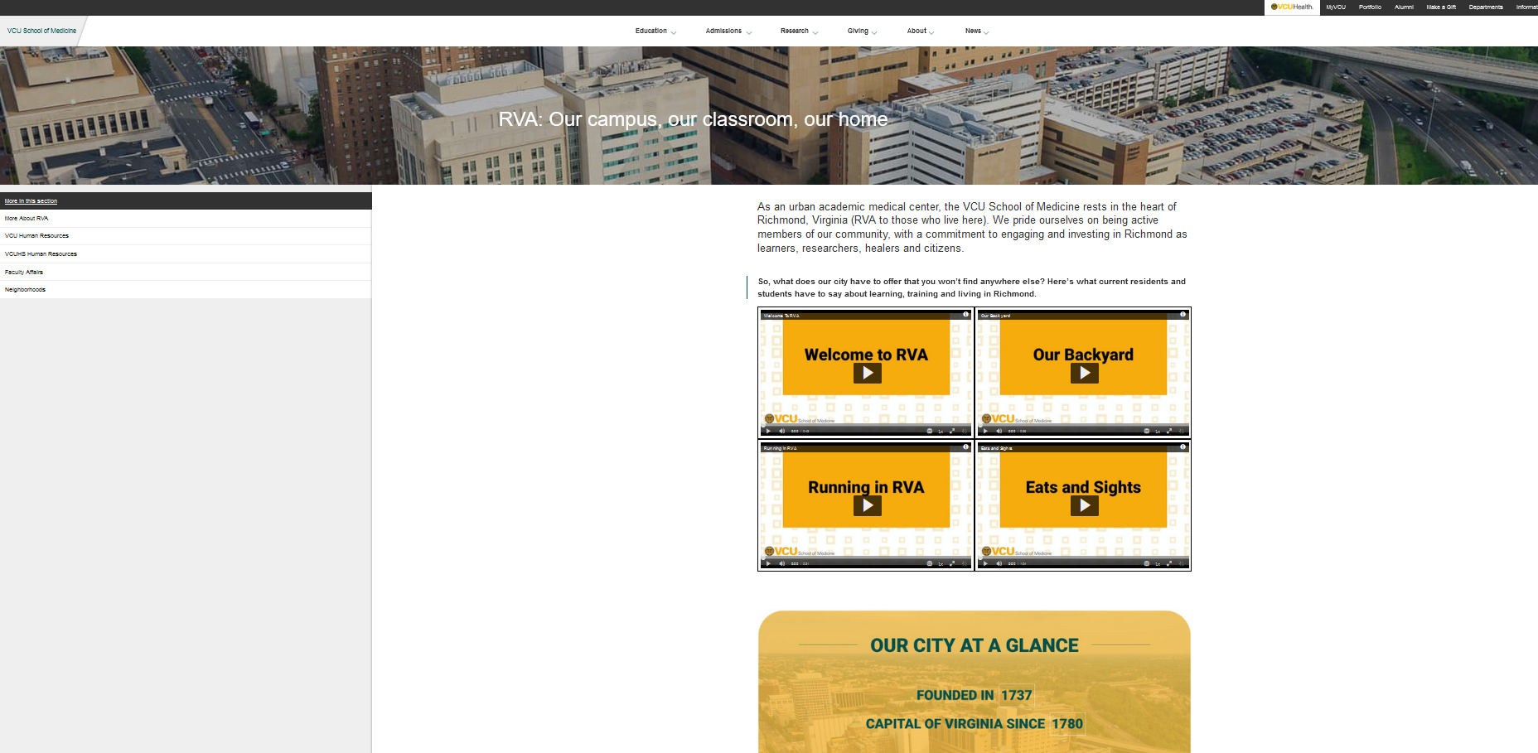
OUR PANELISTS
https://medschool.vcu.edu/rva/
Sam Gottlieb: gottliebs2@vcu.edu
Helen Anderson: andersonhg@vcu.edu
Ashley Smith: smithan13@vcu.edu
Nick Koelsch: koelschnj@vcu.edu
Destiny Pryor: pryordt@vcu.edu

Slide 80
SOM Student Lounge Grand Re-opening!
Sanger Hall 8-021
Friday, August 18, 12:30-1 pm

Slide 82
LUNCH
Sanger Hall, Room 1-038

Slide 83
Policy on student stipends
Health insurance questions?
Dr. Melissa Tyler gradhealthins@vcu.edu
PHD-SPECIFIC
INFORMATION
100% commitment
Funding coordination
Volunteer/other

