Slide 1
ADVANCED DEGREE ORIENTATION
Welcome!
Hoşgeldiniz أهلا بك 欢迎 خوش آمدید Bienvenidos Bienvenue
स्वागत हे

Slide 2
ADVANCED DEGREE ORIENTATION
Mike Grotewiel, Ph.D.
Senior Associate Dean for Graduate Education
School of Medicine
Virginia Commonwealth University
August 15, 2024

Slide 3
ADVANCED DEGREE ORIENTATION
Dr. Mike Grotewiel: Resources and Action Items
Dr. Aron Lichtman: Graduate Student Affairs
Ms. Debbie Roberts: Division for Academic Success
Dr. Tonya Osmond: VCU Counseling Services
Dr. Anita Navarro and Graduate Student Panel
Dr. Art Saavedra: Dean of the School of Medicine
Dr. Mike Grotewiel: Wrap-up with all and PHD-specific

Slide 4
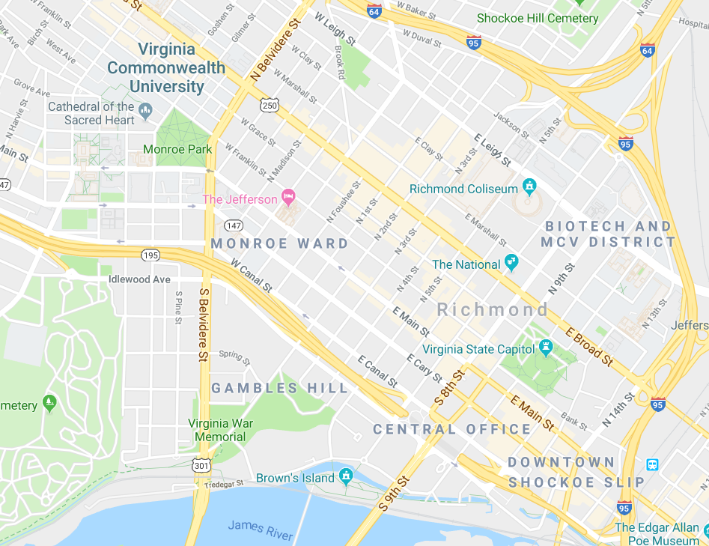
THE CAMPUSES
~1.5 miles (~2.5 km) between two campuses
VCU Parking & Transportation
Resources on both campuses
Use MCV resources whenever possible
MP
MCV

Slide 5
RESOURCES FOR STUDENTS
VCU Offices
SOM Office of Graduate Education
Program Directors, Advisors, Instructors
~250 SOM Graduate Students

Slide 6
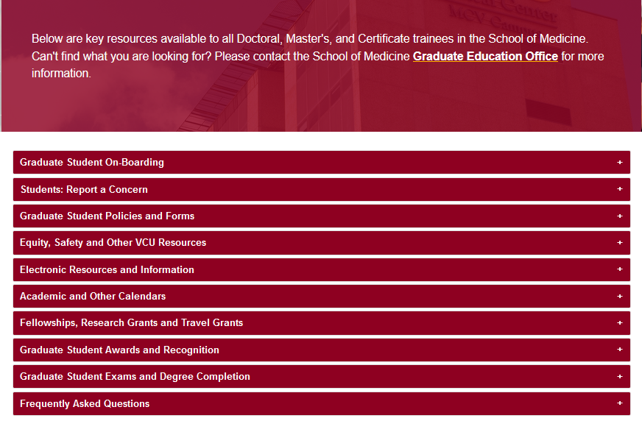
https://medschool.vcu.edu/education/graduate/current-students/
RESOURCES FOR STUDENTS
Everyone wants you to succeed!
Use the available resources!

Slide 7
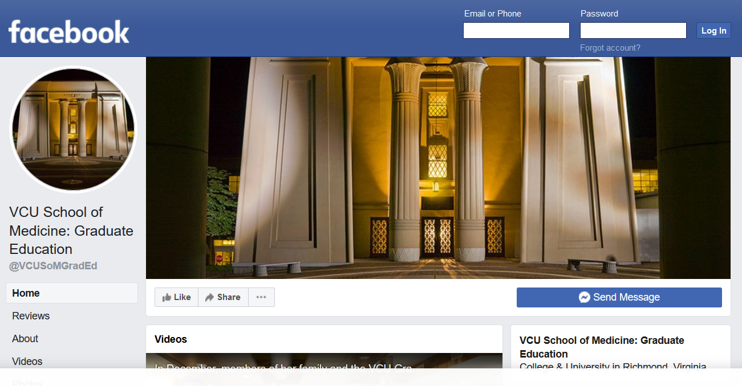
RESOURCES FOR STUDENTS
https://www.facebook.com/VCUSoMGradEd/

Slide 8
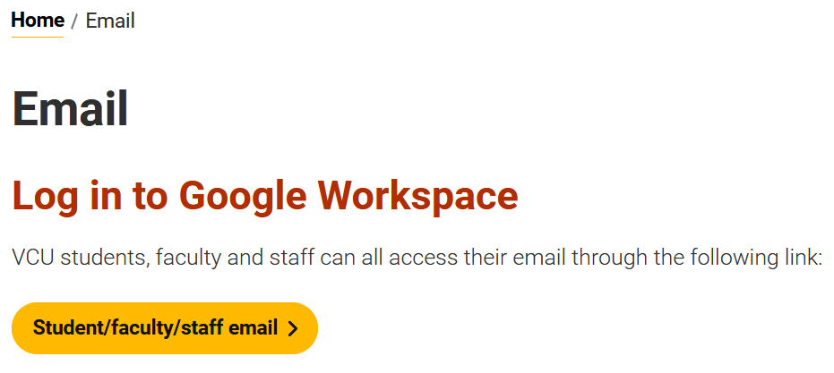
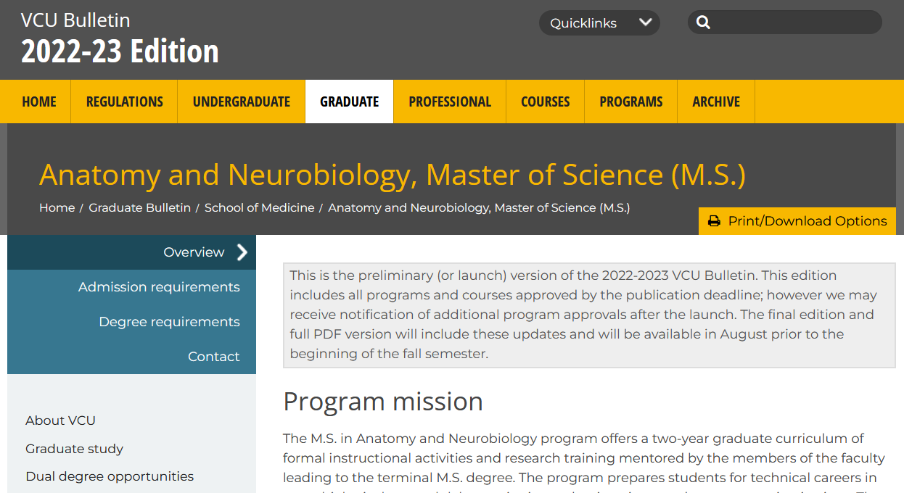
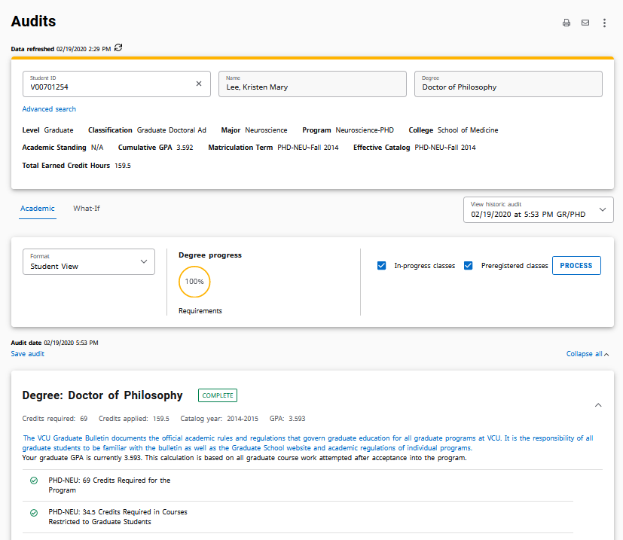
OTHER KEY INFORMATION
email: official means of VCU communication
VCU Bulletin: official degree requirements
DegreeWorks: official degree audit tool

Slide 9
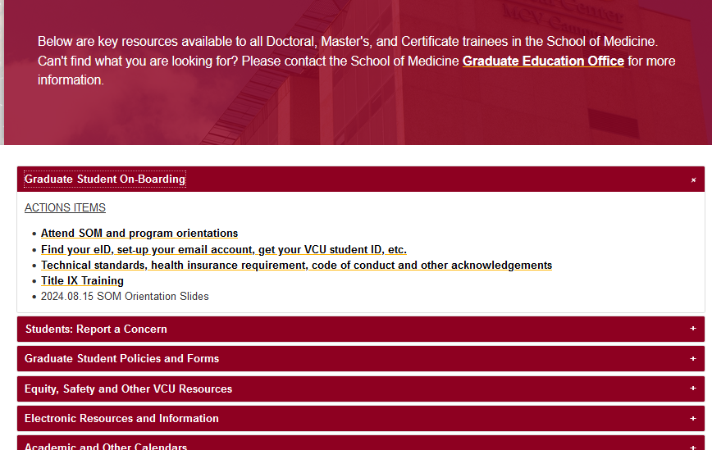
https://medschool.vcu.edu/education/graduate/current-students/
ACTION ITEMS
FOR STUDENTS
Before 8/20: Meet with Program Directors, register for classes
On 8/20: attend classes ☺

Slide 10
ADVANCED DEGREE ORIENTATION
Welcome!
Hoşgeldiniz أهلا بك 欢迎 خوش آمدید Bienvenidos Bienvenue
स्वागत हे

Slide 11
ADVANCED DEGREE ORIENTATION
Aron Lichtman, Ph.D.
SOM Director of Graduate Student Affairs
School of Medicine
Virginia Commonwealth University

Slide 12
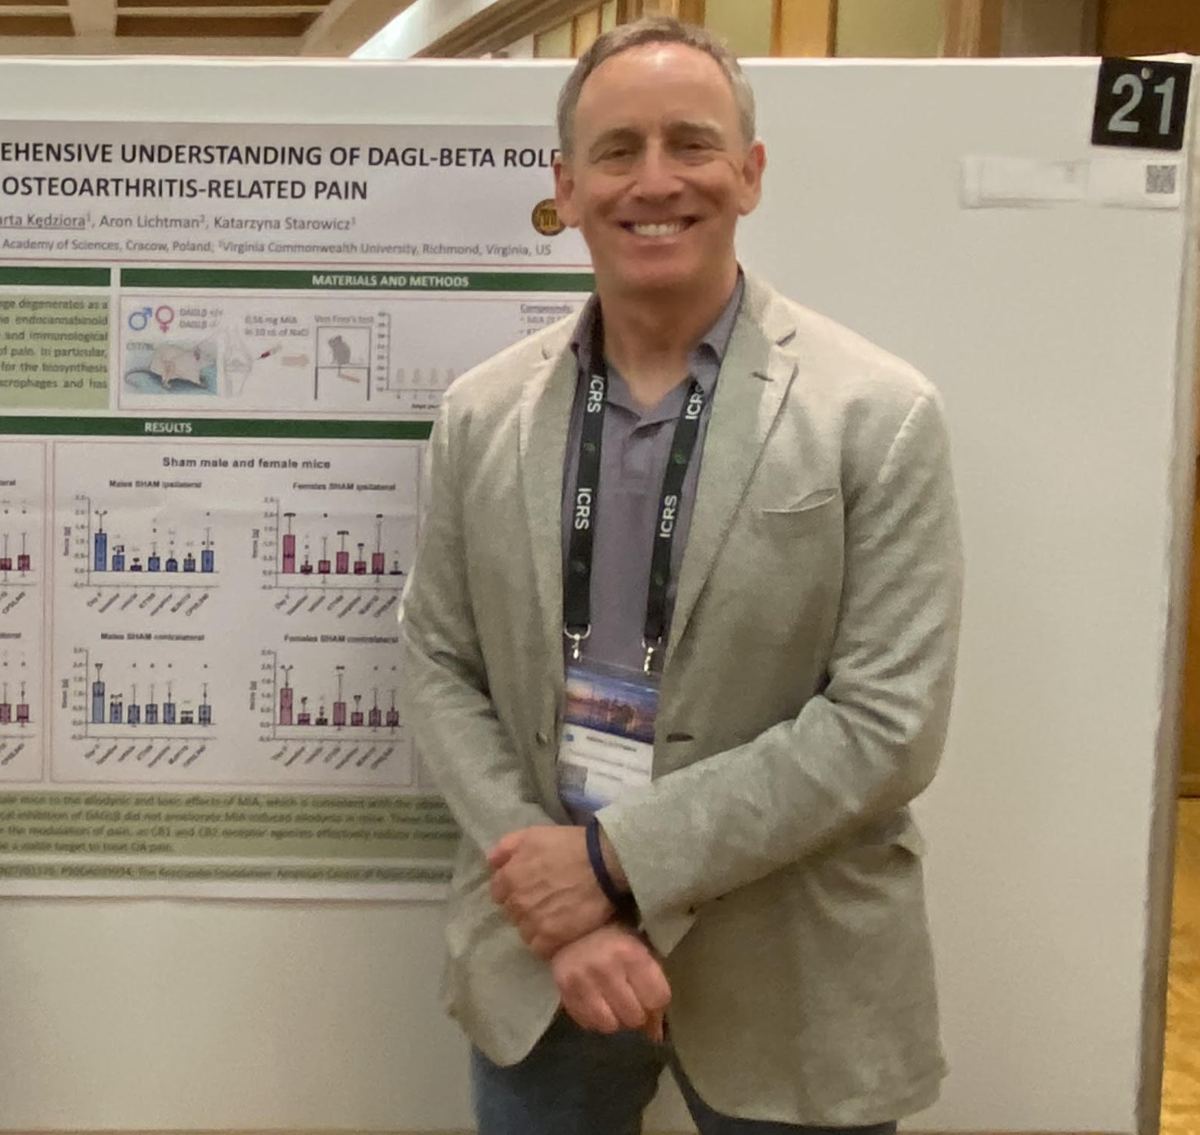
Aron H. Lichtman, Ph.D. Professor of Pharmacology and Toxicology SOM Director of Graduate Student Affairs
Enhance Graduate Student Training
Enhance Graduate Student Experience
Graduate Student Advocate
SOM Travel Awards
Oversee SOM Graduate Student Appeals Process

Slide 13
ADVANCED DEGREE ORIENTATION
Debbie Roberts, M.Ed.
Division for Academic Success
Assistant Director
Virginia Commonwealth University

Slide 14
VMI Building, 2nd Floor(Suite 231)
Debbie Roberts
Brandi Daniels

Slide 15
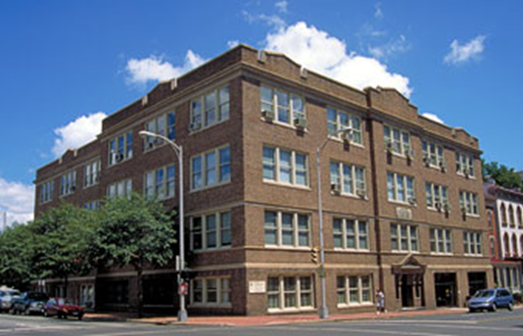
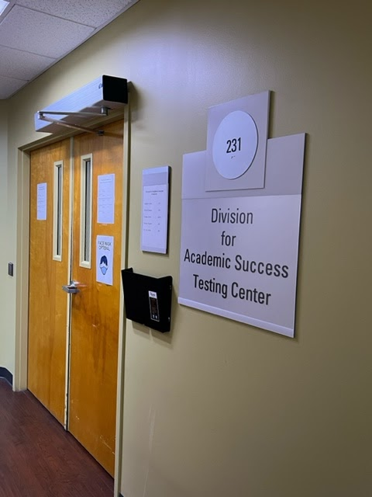
Division of Academic Success
The Division for Academic Success (DAS) offers disability and academic support services to students in the VCU Health Sciences schools.

Slide 16
Academic Accommodations
A student with an ADA qualifying disability or condition has the right to request reasonable academic accommodations.
Accommodations are granted to students who have a documented disability
Accommodations allow students access to demonstrate their knowledge of the content of the curriculum
Accommodations do not compromise the technical standards of the program

Slide 17
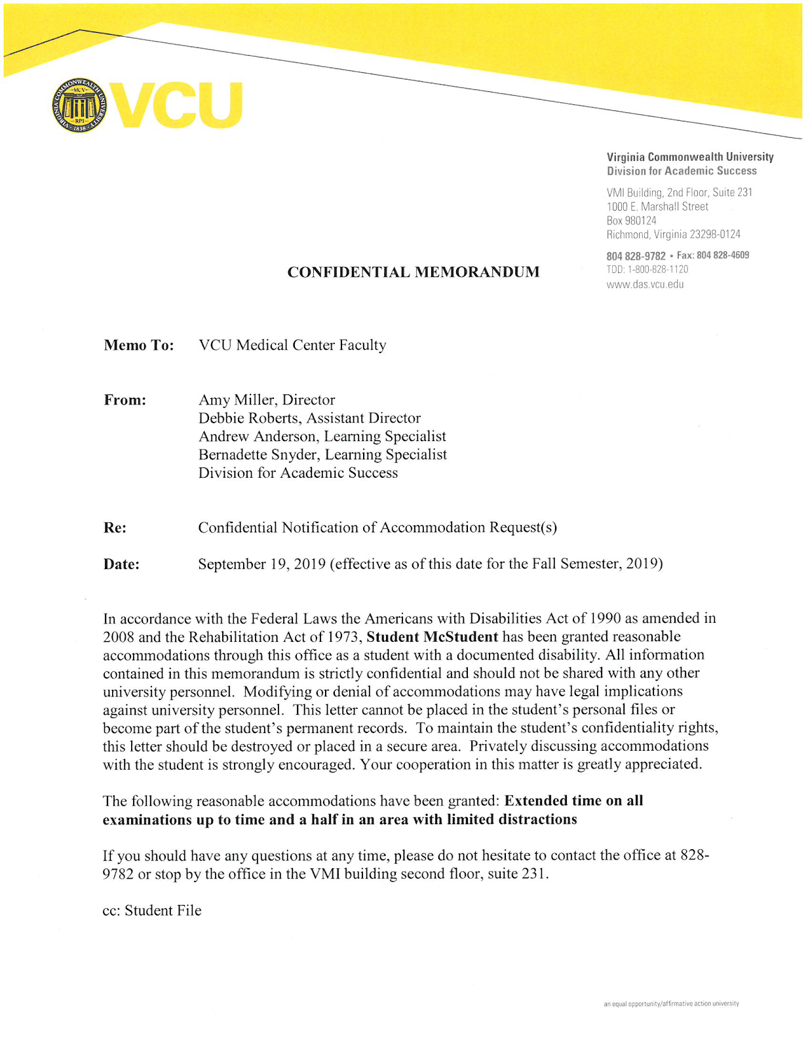
What’s the process?
Complete the online intake form: https://das.vcu.edu/
Meet with an Academic Counselor
Provide medical documentation from your service provider
Accommodation letters provided for you to give to your professors
Sample

Slide 18
Academic Support Services (available for every student)
Study Skills
Exam/Test-taking Skills
Note-taking Skills
Time Management Strategies
MBTI
Learning Connection Inventory

Slide 19
Structure your thinking about
how to tackle the task,
when to use a specific strategy and
why using that particular strategy is effective.

Slide 20
Division for Academic Success
1000 E. Marshall St. (VMI Building)
Suite 231
das.vcu.edu
acadsuccess@vcu.edu

Slide 21
ADVANCED DEGREE ORIENTATION
Tonya Osmond, EdD, LPC
University Counseling Services
Virginia Commonwealth University

Slide 22
VIRGINIA COMMONWEALTH UNIVERSITY
University Counseling Services
Tonya Osmond, EdD, LPC

Slide 23
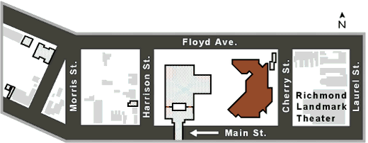
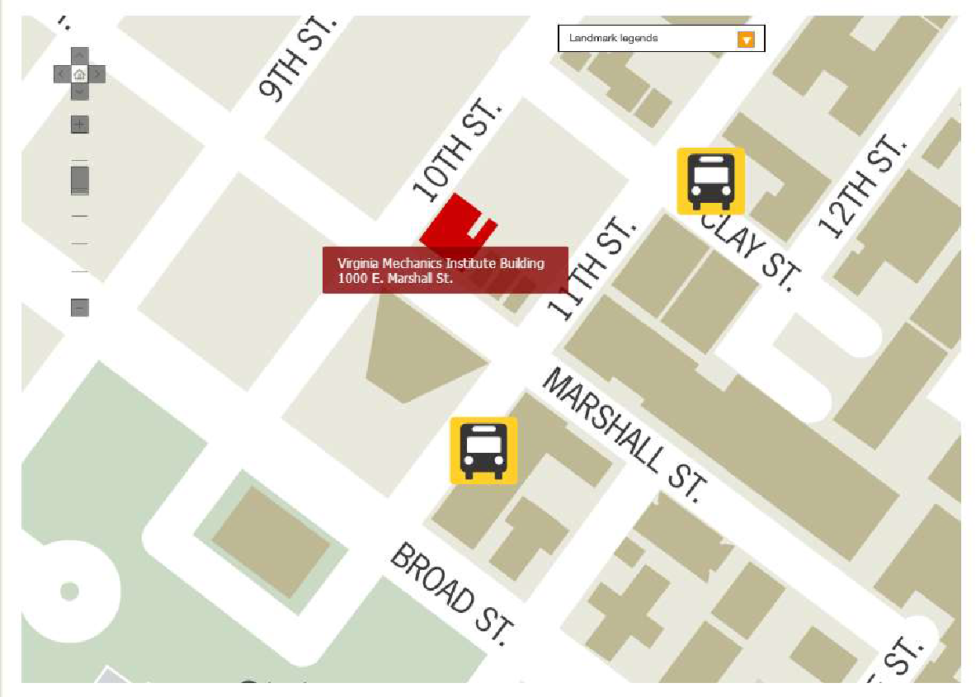
Where are our offices?
Monroe Park Campus
Student Commons – Room 238
907 Floyd Ave.
804-828-6200
M - F 8:00am – 5:00pm
MCV Campus
VMI Building, 4th floor – Room 412
1008 E. Marshall St.
804-828-6200
M & T 11:30am – 8:00pm | W 11:30am-5:00pm
Th - F 8:00am – 5:00pm
Notes:
Talk a bit about what the RAM entails, including the fact that we make a recommendation based on their needs/presenting concerns

Slide 24
UCS Basics
UCS Services are available to enrolled VCU students, and are free of charge
Information disclosed in clinical sessions is confidential

Slide 25
Individual Therapy
Group Therapy
Relationship Therapy
Identity-based Support Groups
Skills Groups
Case Management
Advocacy
Rams in Recovery
24/7/365 Crisis Services
AVAILABLE
SERVICES
Services will be offered both in-person and via Zoom.
Notes:
Provide quick background information about services – touching on Advocacy and RnR

Slide 26
Accessing Services
Students can come to either of our office locations or call our main number at 804-828-6200 to initiate services
Students will be given instructions for completing initial paperwork, and will be scheduled to meet with a UCS clinician for a RAM (Referral and Assessment Meeting)
RAMs are designed to assess student’s mental health needs and to provide information and treatment recommendations

Slide 27
Crisis Services
Drop-in crisis times are available at both locations during the regular 8am-5pm work day
After hours crisis services are available 24/7/365. Students in crisis can call 804-828-6200 to speak to a crisis clinician

Slide 28
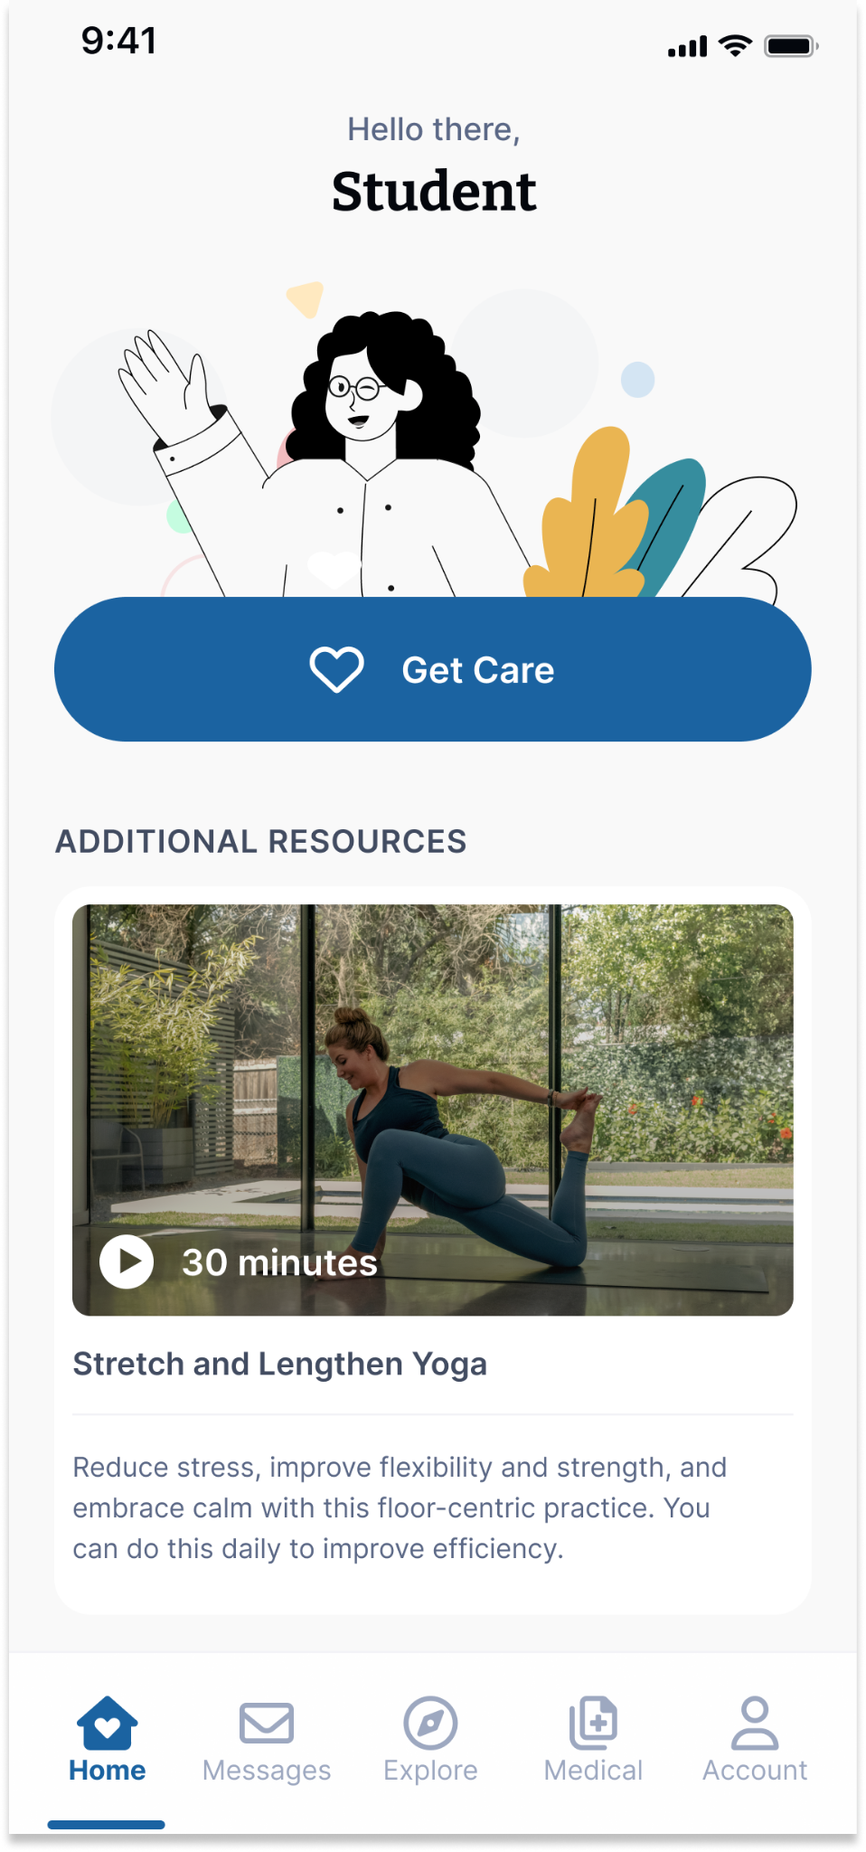
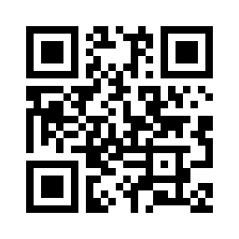
Your Virtual Health and Well-Being Resources
Available on the TimelyCare app or timelycare.com/vcu
Health Coaching
Use this to help develop healthy lifestyle behaviors.
TalkNow
24/7, on-demand emotional support to talk about anything.
Self-Care Content
Visit the “Explore” page for guided self-care content.
Scheduled Counseling
Choose your preferred day, time, and mental health provider.
Scan the QR Code to access care.
@timelycare
QR CODE HERE
It’s for Students.
@timelycare
FOR FREE.
@timely_care

Slide 29
Common concerns addressed
at UCS
Anxiety
Depression
Stress
Trauma
Relationship Problems
Family Issues
Academic Functioning
Adjustment/Life Transitions
Grief/Loss
Cultural/Identity Issues

Slide 30
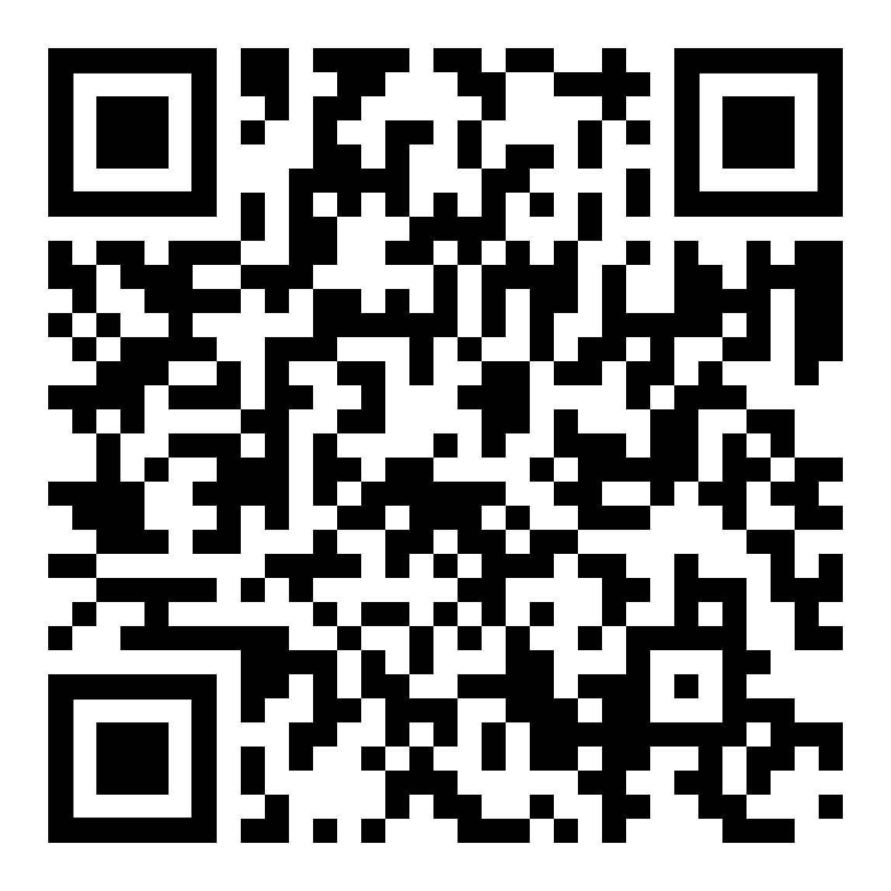
Black Voices
Rainbow Group
Latinx Voices
International Student Discussion
Asian Voices
Survivors of Sexual Violence
Students with Chronic Health Conditions
Grief Support Group
ADHD Support & Skills Group
Support Groups
More info and sign ups here:

Slide 31
Advocacy Services
Rams in Recovery
Non-therapeutic support after
experiencing sexual assault, dating
violence, and/or stalking.
University Student Commons 907 Floyd Ave., Suite 238 (804) 828-6200 myoptions@vcu.edu
M - F: 8:00am – 5:00pm
Structured support for students in recovery from substance use.
The Recovery Clubhouse 1103 W. Marshall St (804) 366-8027 recovery@vcu.edu
T - Th: 10:00am – 5:00pm Drop-ins and Individual Study Spaces

Slide 32
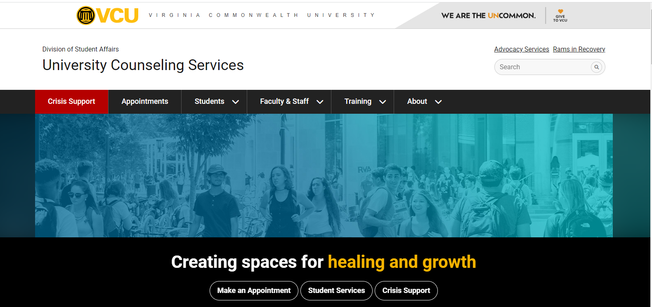
counseling.vcu.edu

Slide 33
ADVANCED DEGREE ORIENTATION
Anita Navarro, EdD, moderator
Student Panel “What to Expect in Graduate School”
Lauren Moncayo, PhD Pharmacology & Toxicology
Jean Gonzales, PhD Biochemistry
Stephen Vieno, MS Human Genetics
Holly Byers, PhD Human Genetics/MS Genetic Counseling

Slide 34
ADVANCED DEGREE ORIENTATION
Arturo Saavedra, M.D., Ph.D., M.B.A.
Dean
School of Medicine
Virginia Commonwealth University

Slide 35
ADVANCED DEGREE ORIENTATION
Mike Grotewiel, Ph.D.
Senior Associate Dean for Graduate Education
School of Medicine
Virginia Commonwealth University

Slide 36
QUESTIONS AND ANSWERS
Only 3 answers!
Contact my program director
or course director!
Very, very important!
YES!

Slide 37
QUESTIONS AND ANSWERS
You are confused about course registration. What should you do?
How important is that?
Will they help you?
Contact my program director
or course director!
Very, very important!
YES!

Slide 38
QUESTIONS AND ANSWERS
You did not do well on an assignment. What should you do?
How important is that?
Will they help you?
Contact my program director
or course director!
Very, very important!
YES!

Slide 39
QUESTIONS AND ANSWERS
You have a question about resources that might be available. What should you do?
How important is that?
Will they help you?
Contact my program director
or course director!
Very, very important!
YES!

Slide 40
QUESTIONS?

