Slide 1


ADVANCED DEGREE ORIENTATION
Mike Grotewiel, Ph.D.
Senior Associate Dean for Graduate Education
School of Medicine
Virginia Commonwealth University
August 14, 2025

Slide 2
ADVANCED DEGREE ORIENTATION
Dr. Mike Grotewiel: Resources and Action Items
Dr. Art Saavedra: Dean of the School of Medicine
Ms. Debbie Roberts: Division for Academic Success
Dr. Miki Skinner: VCU Counseling Services
Dr. Anita Navarro and Graduate Student Panel
Gilbert Glago: Graduate Student Leadership Council
Sachin Kumar Kempelingaiah: International Student Group
Dr. Mike Grotewiel: Wrap-up with all and PHD-specific

Slide 3


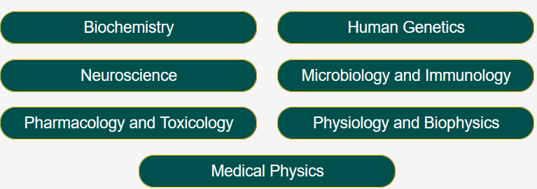
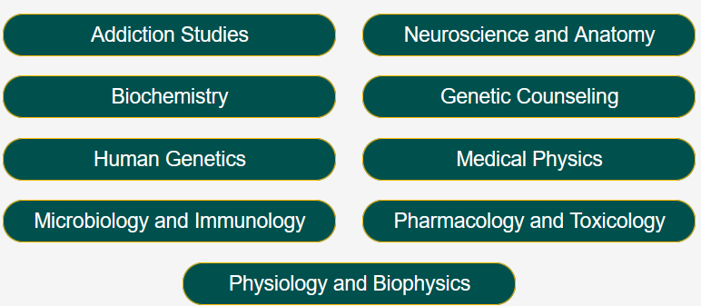
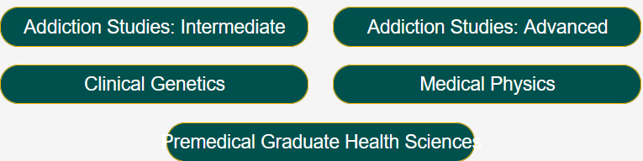
RESOURCES FOR STUDENTS
Ph.D.
M.S.
Certificate

Slide 4
RESOURCES FOR STUDENTS
VCU Offices
SOM Office of Graduate Education
Program Directors, Advisors, Instructors
>300 SOM Graduate Students

Slide 5

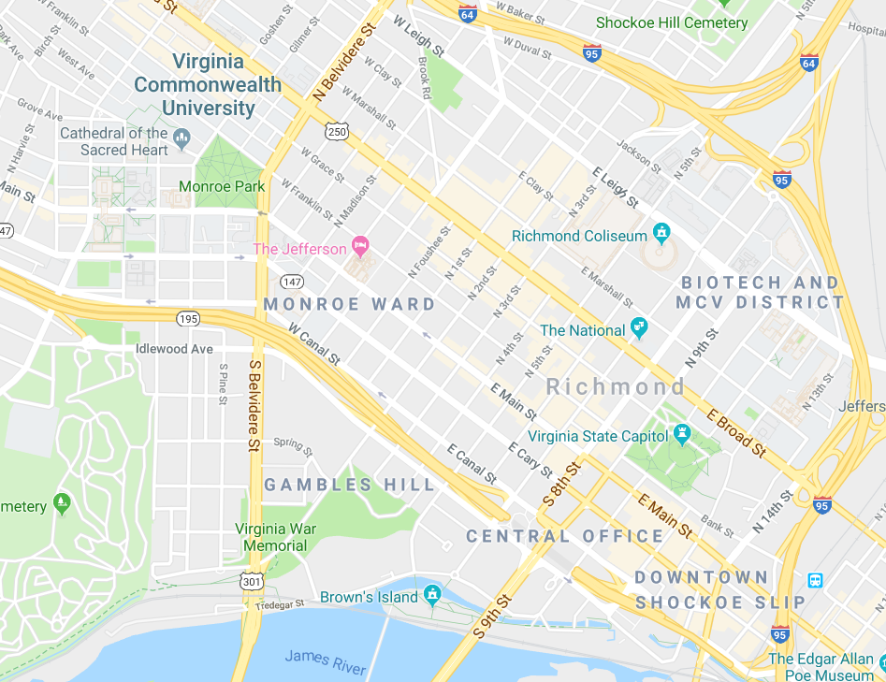
RESOURCES FOR STUDENTS
~1.5 miles (~2.5 km) between two campuses
VCU Parking & Transportation
Resources on both campuses
Use MCV resources whenever possible
`````````````````
MP
```````````````````````````````````````````````````````````````````
MCV

Slide 6
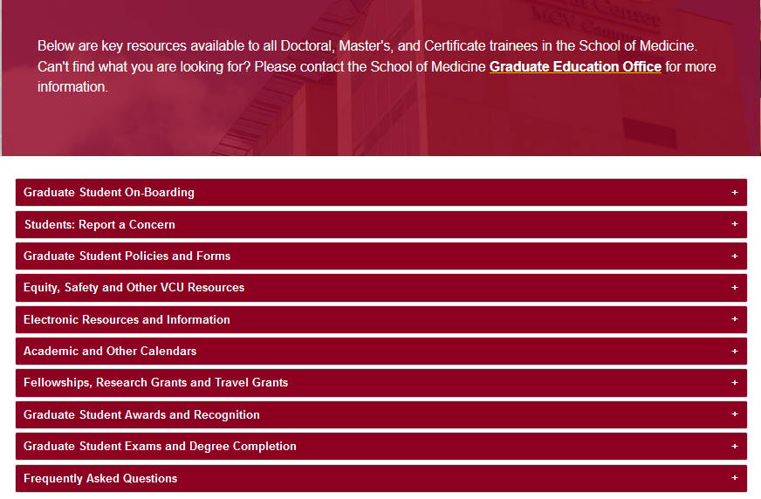
https://medschool.vcu.edu/education/graduate/current-students/
RESOURCES FOR STUDENTS
Everyone wants you to succeed!
Use the available resources!
Stephanie Ganser-Director of Student Engagement

Slide 7
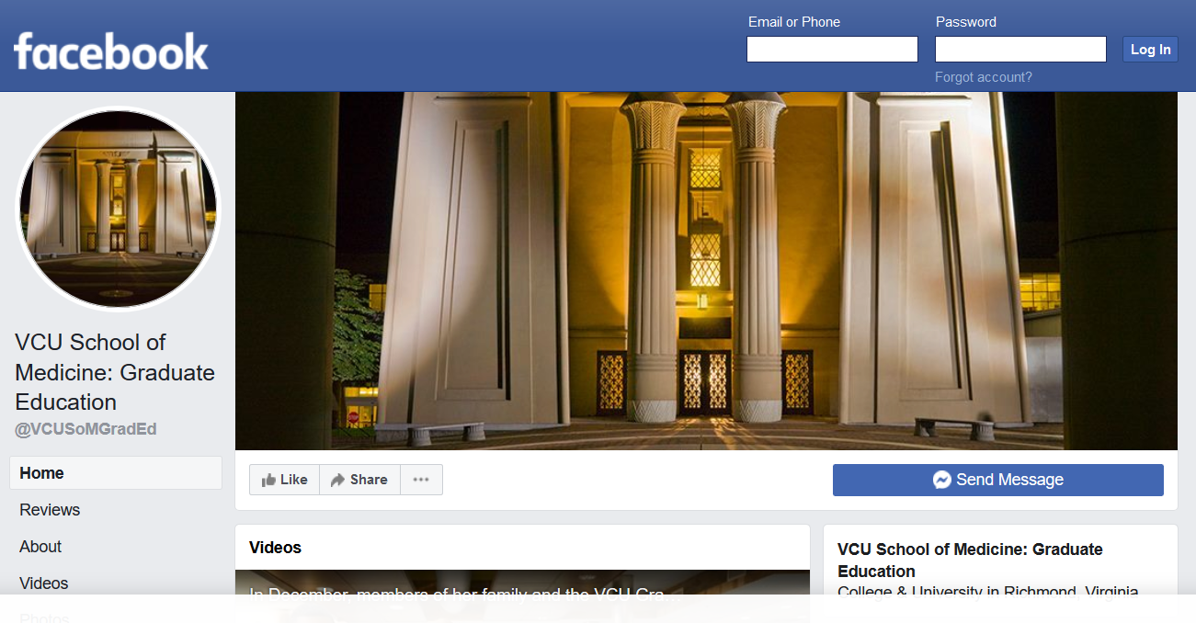
RESOURCES FOR STUDENTS
https://www.facebook.com/VCUSoMGradEd/

Slide 8
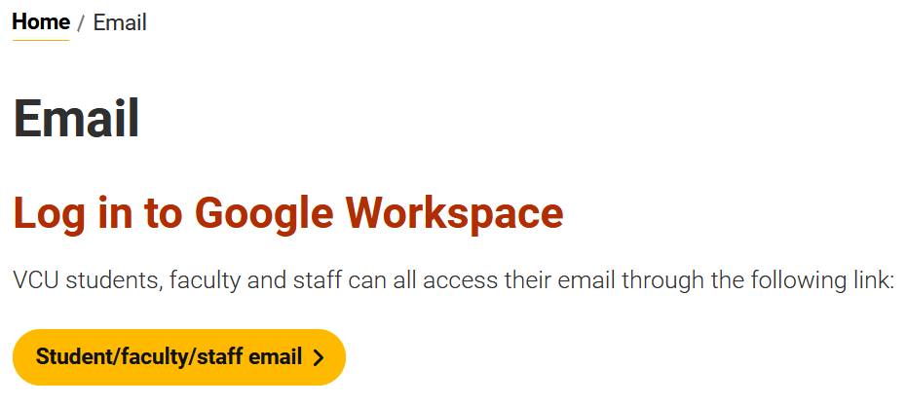
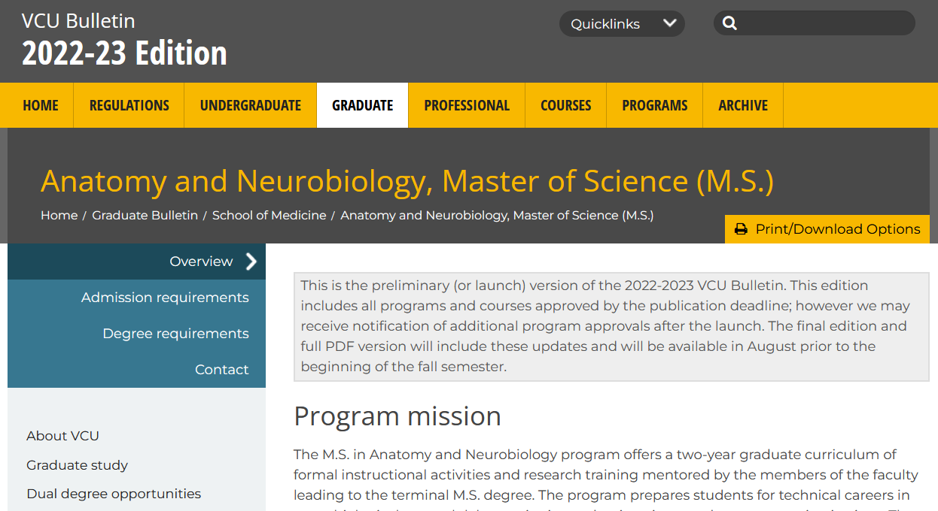
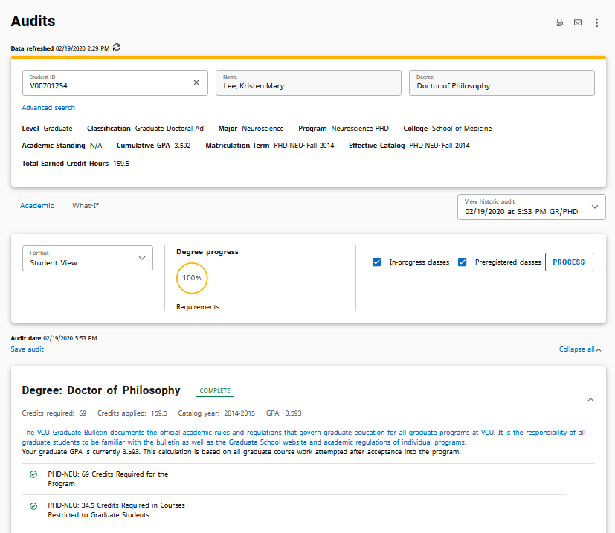
OTHER KEY INFORMATION
email: official means of VCU communication
VCU Bulletin: official degree requirements
DegreeWorks: official degree audit tool

Slide 9
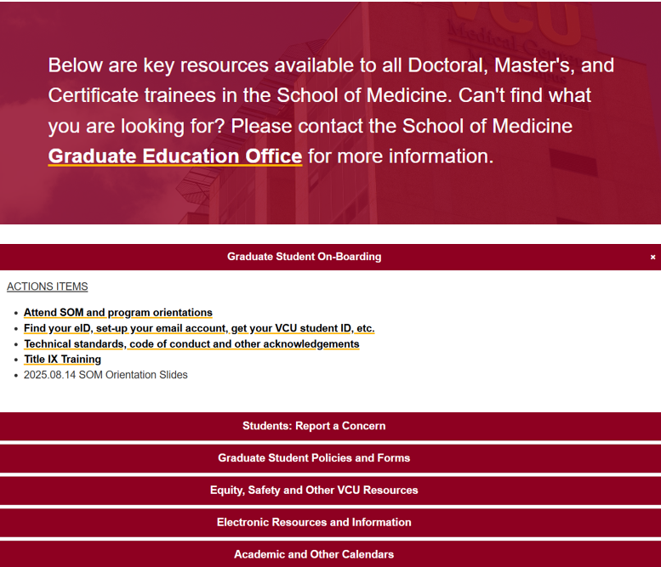
https://medschool.vcu.edu/education/graduate/current-students/
ACTION ITEMS
FOR STUDENTS
Before 8/19: meet with Program Directors, register for classes
By 8/19: initiate training ☺

Slide 10
ADVANCED DEGREE ORIENTATION
Welcome!

Slide 11
ADVANCED DEGREE ORIENTATION
Arturo Saavedra, M.D., Ph.D., M.B.A
Dean
School of Medicine
Virginia Commonwealth University

Slide 12
ADVANCED DEGREE ORIENTATION
Debbie Roberts, M.Ed.
Division for Academic Success
Assistant Director
Virginia Commonwealth University

Slide 13
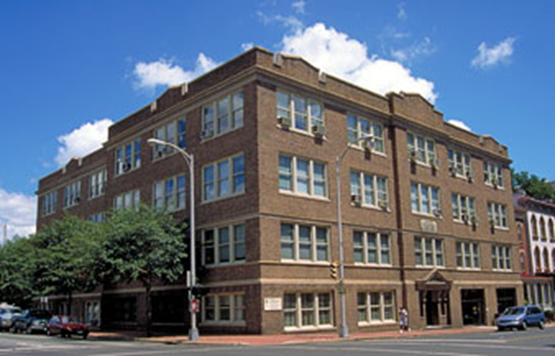
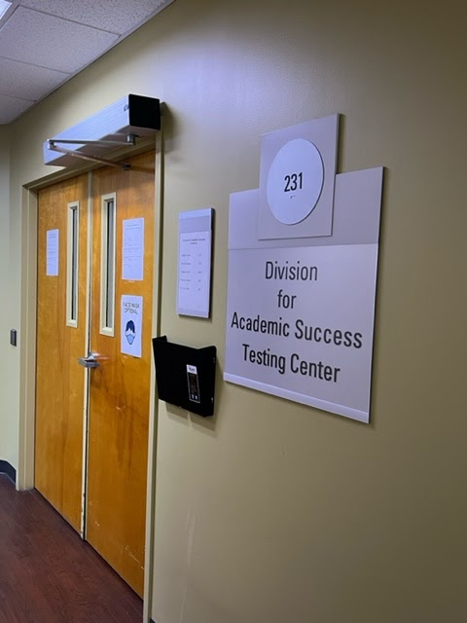
Division of Academic Success
The Division for Academic Success (DAS) offers disability and academic support services to students in the VCU Health Sciences schools.

Slide 14
Academic Accommodations
A student with an ADA qualifying disability or condition has the right to request reasonable academic accommodations.
Accommodations are granted to students who have a documented disability
Accommodations allow students access to demonstrate their knowledge of the content of the curriculum
Accommodations do not compromise the technical standards of the program

Slide 15
Academic Support Services (available for every student)
Study Skills
Exam/Test-taking Skills
Note-taking Skills
Time Management Strategies
Learning Connection Inventory
das.vcu.edu
acadsuccess@vcu.edu

Slide 16
ADVANCED DEGREE ORIENTATION
Miki Skinner, Ph.D.
Assistant Director
University Counseling Services
Virginia Commonwealth University

Slide 17

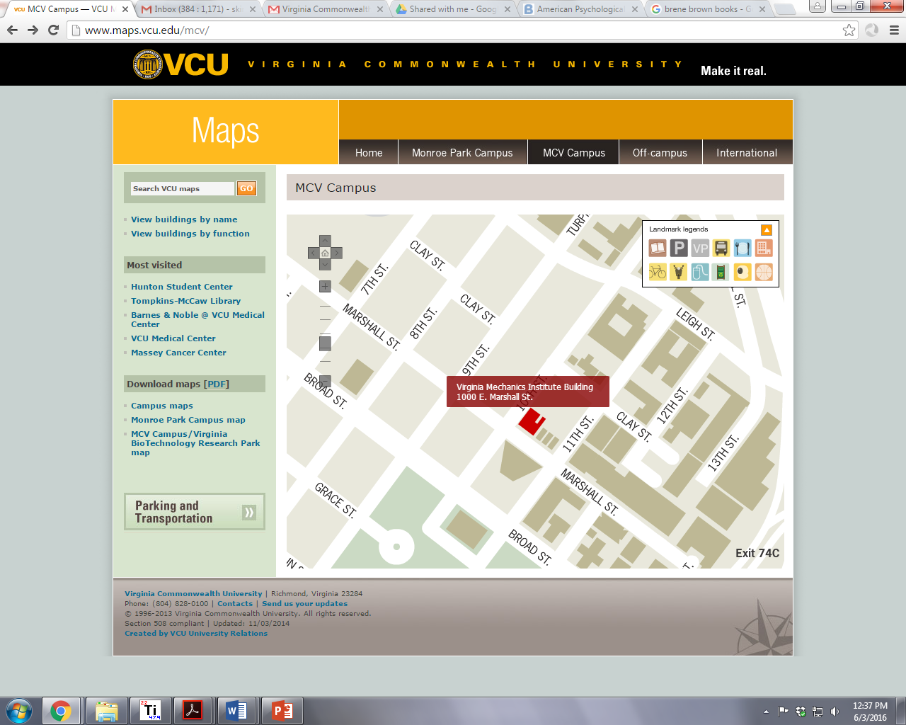
Website: https://counseling.vcu.edu/
Phone number:
(804) 828-6200
Mon 10am-7pm
Tue,Thu, Fri 8am-5pm
Wed 11:30am-5pm
Crisis: 24hr/day
Notes:
Liaison role - we all work with dentistry

Slide 18
Outreach
Crisis Services
Clinical Services
Confidentiality - few exceptions - not shared with the school
Survivor Support Services
Rams in Recovery
Notes:
Exceptions to confidentiality include risk to self or others, current abuse of child or vulnerable adult, or if records are subpoenaed

Slide 19


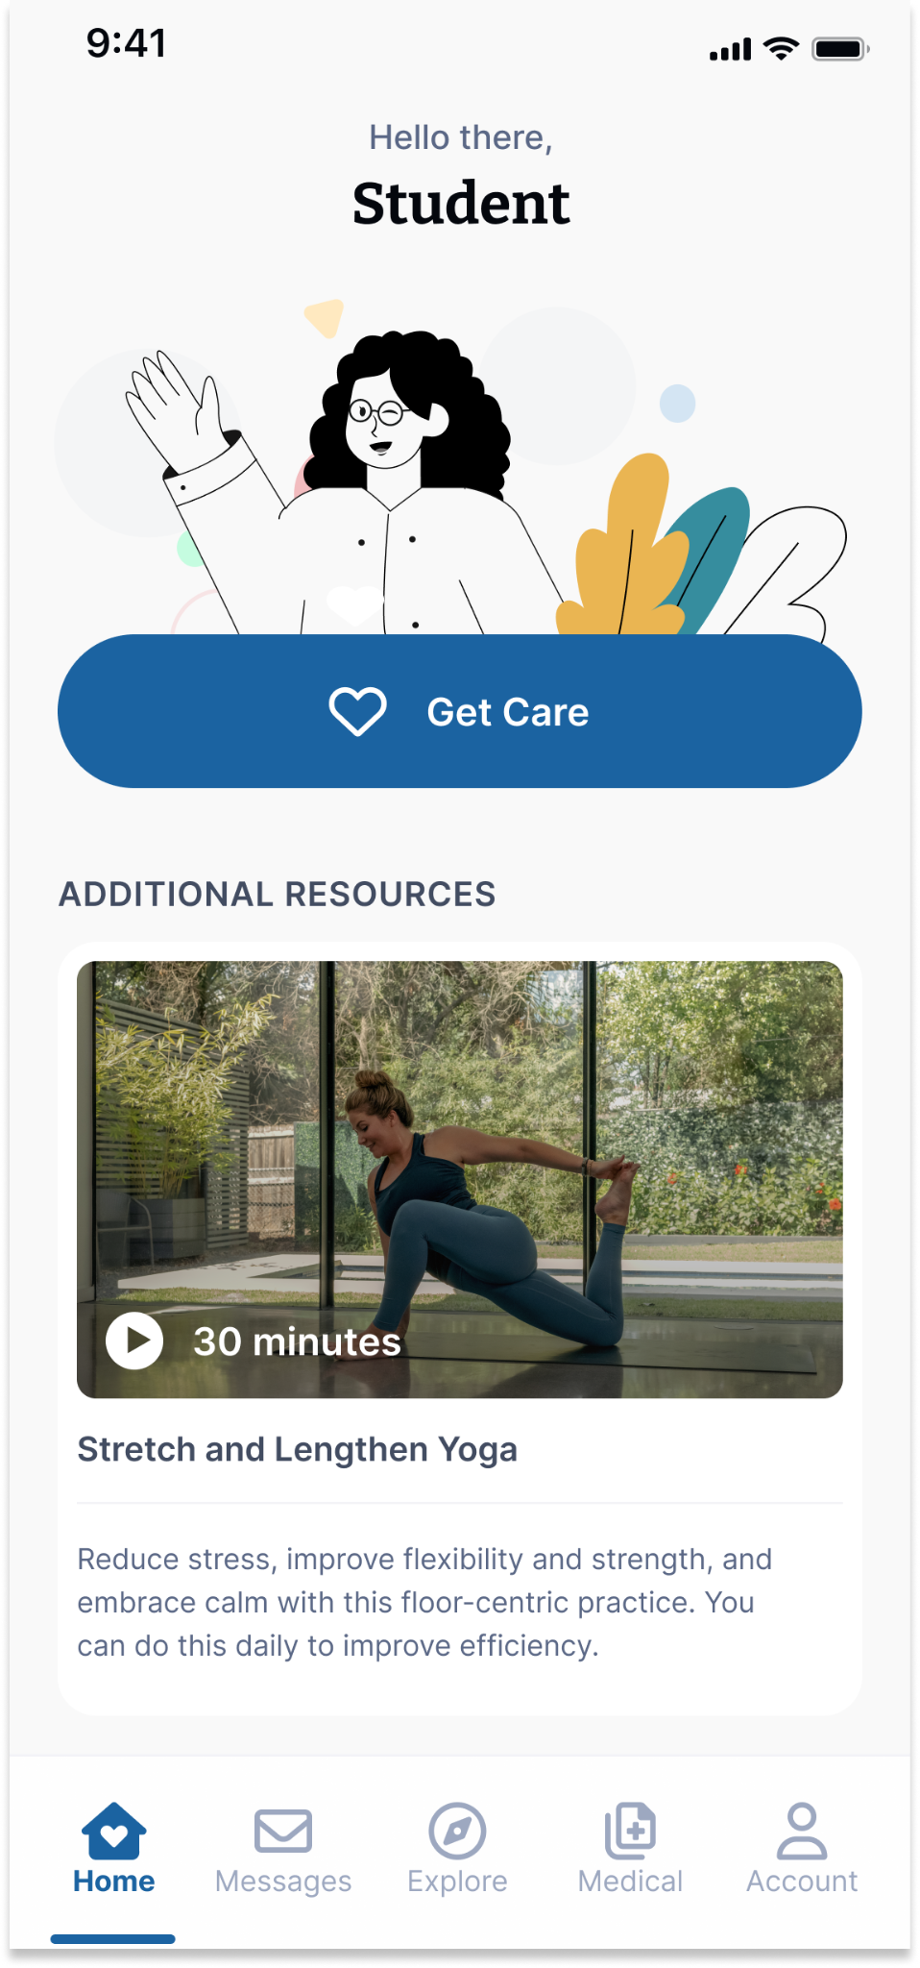




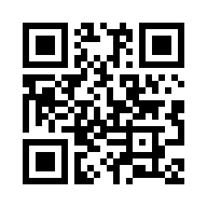



Your Virtual Health and Well-Being Resources
Available on the TimelyCare app or timelycare.com/vcu
Health Coaching
Use this to help develop healthy lifestyle behaviors.
TalkNow
24/7, on-demand emotional support to talk about anything.
Self-Care Content
Visit the “Explore” page for guided self-care content.
Scheduled Counseling
Choose your preferred day, time, and mental health provider.
Scan the QR Code to access care.
@timelycare
QR CODE HERE
It’s for Students.
@timelycare
FOR FREE.
@timely_care

Slide 20
ADVANCED DEGREE ORIENTATION
Anita Navarro, EdD, moderator
Student Panel “What to Expect in Graduate School”
Alex Counts, PhD Microbiology & Immunology
Jensen Goulette, MS Human Genetics
Tomaj Javidtash, MS Medical Physics
Dana Kneisley, PhD Pharmacology & Toxicology
Carson Walker, PhD Human Genetics

Slide 21
ADVANCED DEGREE ORIENTATION
Gilbert Glago, PhD Microbiology & Immunology
Graduate Student Leadership Council
Sachin Kumar Kempelingaiah, PhD Biochemistry
International Student Group

Slide 22


Graduate Student Leadership Council(GSLC)
WHO ARE WE?
The Graduate Student Leadership Council (GSLC) is a student-led initiative composed of representatives from each biomedical research department at VCU School of Medicine.
GSLC was created to:
Empower students to advocate for academic, professional, and personal development needs
Serve as a bridge between graduate students and the SOM Office of Graduate Education
Collaborate with faculty to enhance the overall student experience
What Has GSLC Done So Far?
Mentorship Evaluation and Advocacy
Assess the quality of mentorship students receive from their primary advisors.
Mentee Self-Assessment Survey
Understand how students view their own roles in the mentor-mentee relationship

Slide 23
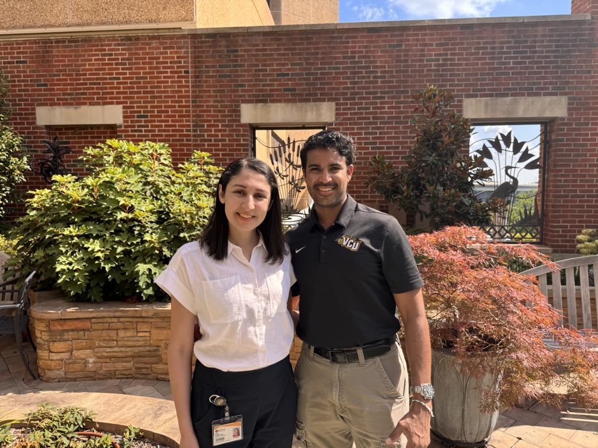
VCU School of Medicine International Student Group (SOMIS)
President (RIGHT): Sachin Kumar Kempelingaiah
1st Year Ph.D. CMGM Department (Biochemistry)
Mentor: Dr. Can Senkal
Vice President (LEFT): Negin Zia Miavaghi
3rd Year Ph.D. CMGM Department (Biochemistry)
Mentor: Dr. Kaustubh Datta

Slide 24
VCU School of Medicine International Student Group (SOMIS)
GOALS:
Create a welcoming environment for current and incoming international students.
Provide a tentative blueprint for students living in the United States on an F-1 visa.
Enhance collaborations within departments of the School of Medicine.
Who can join?
International Ph.D. students
Post Docs
Anyone who’s interested in being part of a cultural and diverse community

Slide 25
THANK YOU
kumarkempelsg@vcu.edu
ziamiavaghn@vcu.edu

Slide 26
ADVANCED DEGREE ORIENTATION
Mike Grotewiel, Ph.D.
Senior Associate Dean for Graduate Education
School of Medicine
Virginia Commonwealth University

Slide 27
QUESTIONS AND ANSWERS
Only 3 answers!
Contact my program director
or course director!
Very, very important!
YES!

Slide 28
QUESTIONS AND ANSWERS
You are confused about course registration. What should you do?
How important is that?
Will they help you?
Contact my program director
or course director!
Very, very important!
YES!

Slide 29
QUESTIONS AND ANSWERS
You did not do well on an assignment. What should you do?
How important is that?
Will they help you?
Contact my program director
or course director!
Very, very important!
YES!

Slide 30
QUESTIONS AND ANSWERS
You have a question about resources that might be available. What should you do?
How important is that?
Will they help you?
Contact my program director
or course director!
Very, very important!
YES!

Slide 31

QUESTIONS?

