Slide 1


ADVANCED DEGREE ORIENTATION
Mike Grotewiel, Ph.D.
Senior Associate Dean for Graduate Education
School of Medicine
Virginia Commonwealth University
August 13, 2026

Slide 2
ADVANCED DEGREE ORIENTATION
Stephen Kates, M.D
Interim Dean
School of Medicine
Virginia Commonwealth University

Slide 3
ADVANCED DEGREE ORIENTATION
Dr. Mike Grotewiel: Resources and Action Items
Ms. Debbie Roberts: Division for Academic Success
Dr. Eva Melendez: VCU Counseling Services
Dr. Anita Navarro and Graduate Student Panel
Student groups: Gilbert Glago, Sachin Kumar Kempelingaiah, Shelbey Strandberg, Jess Bell
Dr. Mike Grotewiel: Wrap-up with all and PHD-specific

Slide 4


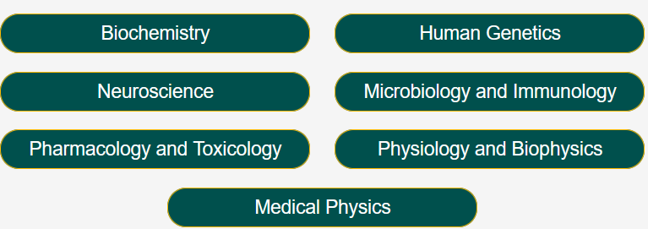
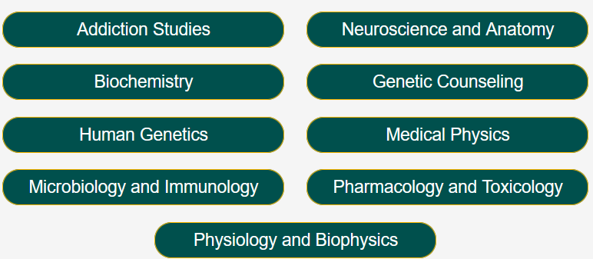
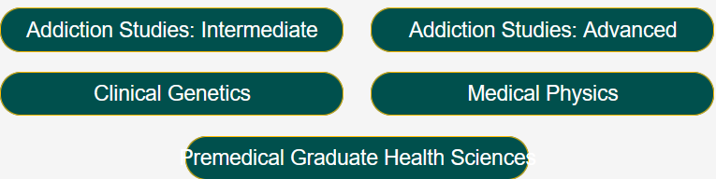
RESOURCES FOR STUDENTS
Ph.D.
M.S.
Certificate

Slide 5
RESOURCES FOR STUDENTS
Mary Rosenthal: executive assistant
Harold Greenwald: OGE coordinator
Jenna Joyner: BSDP coordinator and OGE marketing
Thea Puertolas: marketing intern
Maya Long: marketing intern

Slide 6
RESOURCES FOR STUDENTS
VCU Offices
SOM Office of Graduate Education
SOM Program Directors, Advisors, Instructors
>300 SOM Graduate Students

Slide 7

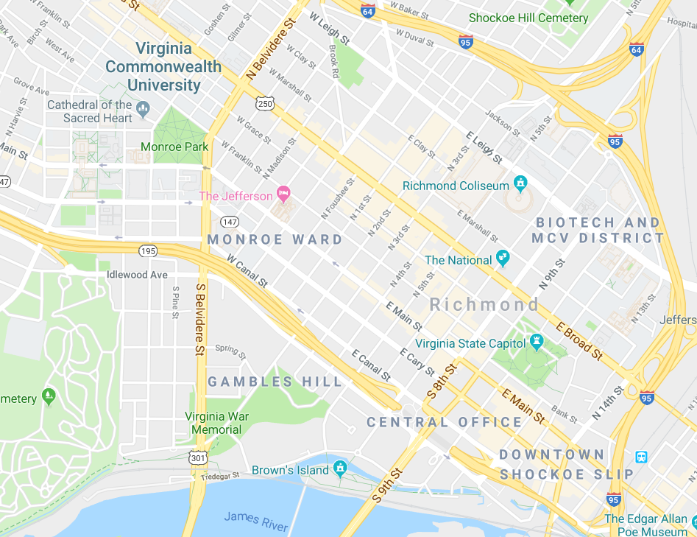
RESOURCES FOR STUDENTS
~1.5 miles (~2.5 km) between two campuses
VCU Parking & Transportation
Resources on both campuses
Use MCV resources whenever possible
`````````````````
MP
```````````````````````````````````````````````````````````````````
MCV

Slide 8
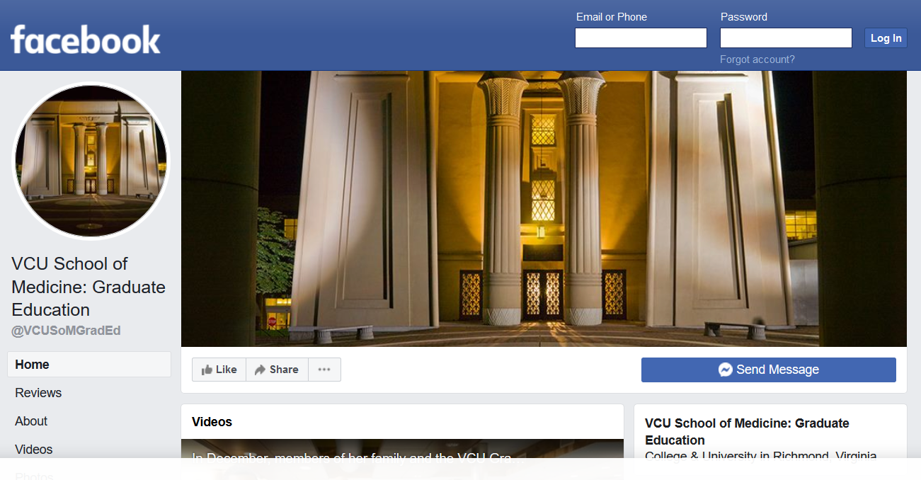
RESOURCES FOR STUDENTS
https://www.facebook.com/VCUSoMGradEd/

Slide 9
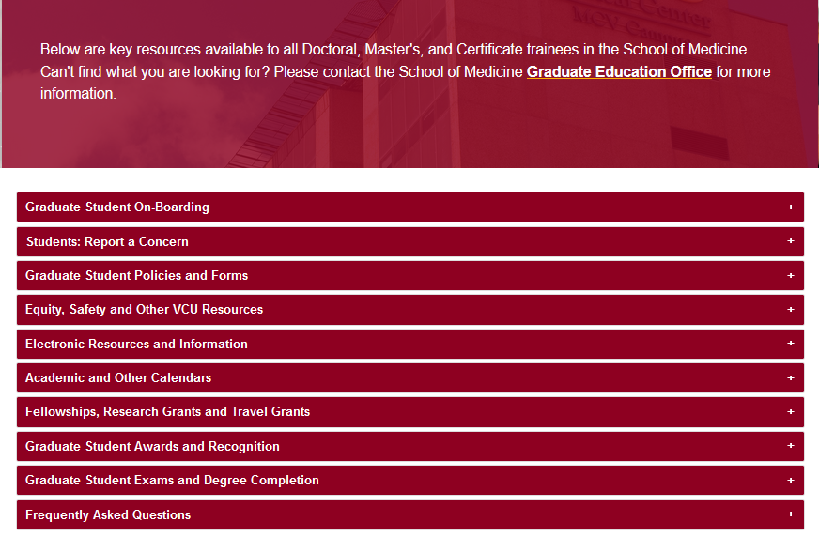
https://medschool.vcu.edu/education/graduate/current-students/
RESOURCES FOR STUDENTS
Everyone wants you to succeed!
Use the available resources!

Slide 10
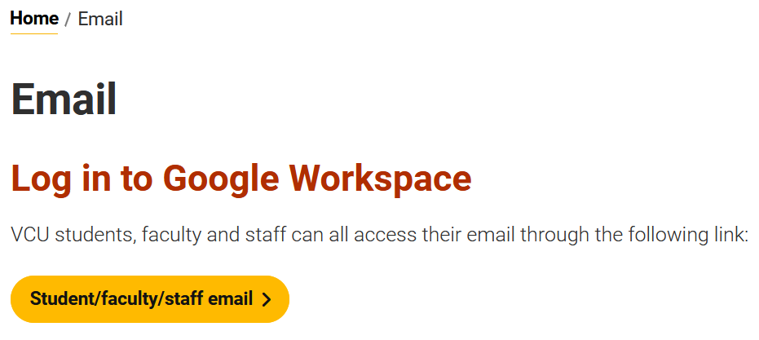
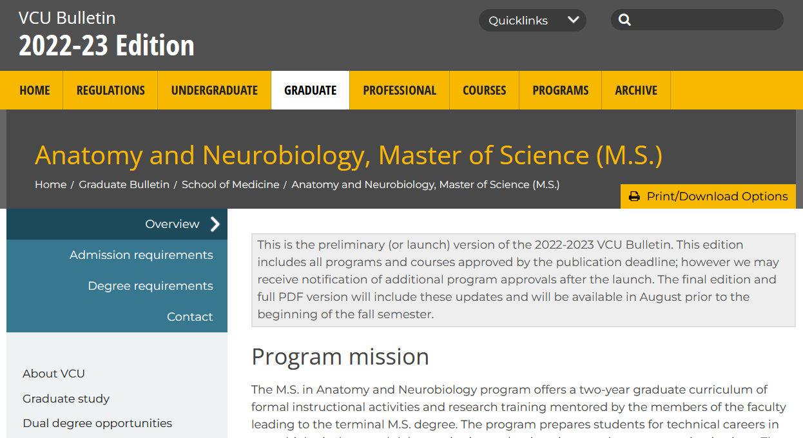
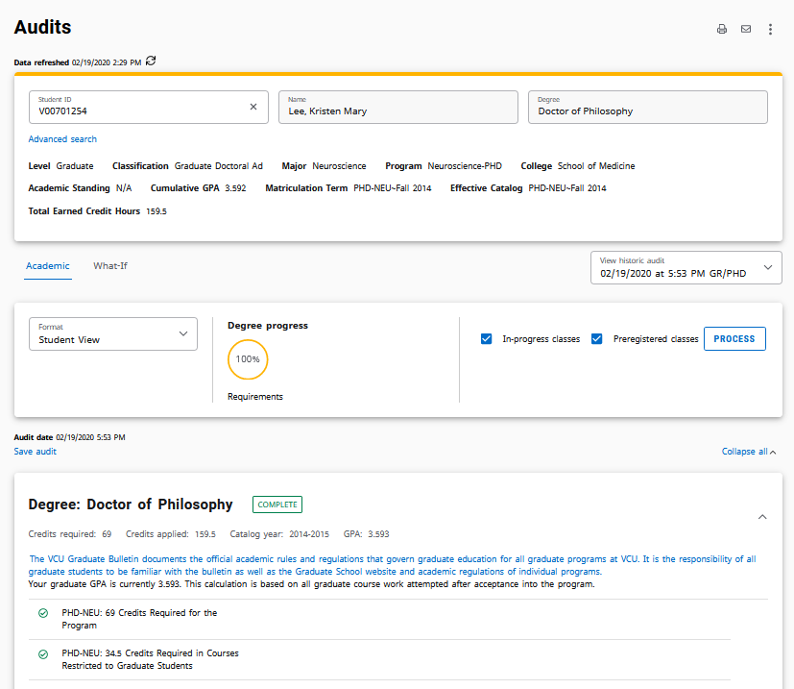
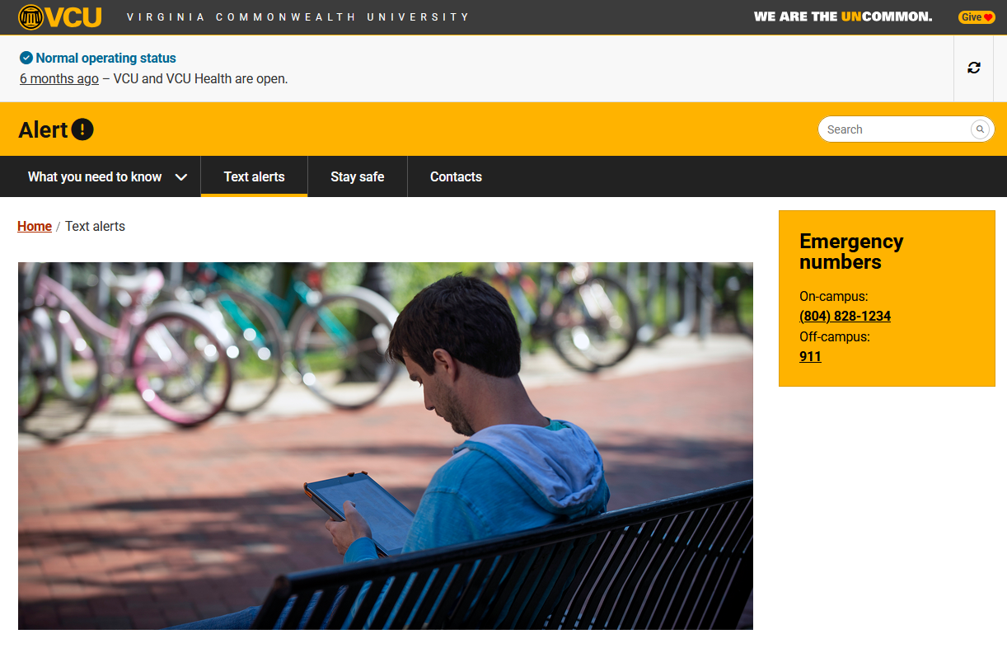
OTHER KEY INFORMATION
email: official means of VCU communication
VCU Bulletin: official degree requirements
DegreeWorks: official degree audit tool
VCU Alerts

Slide 11
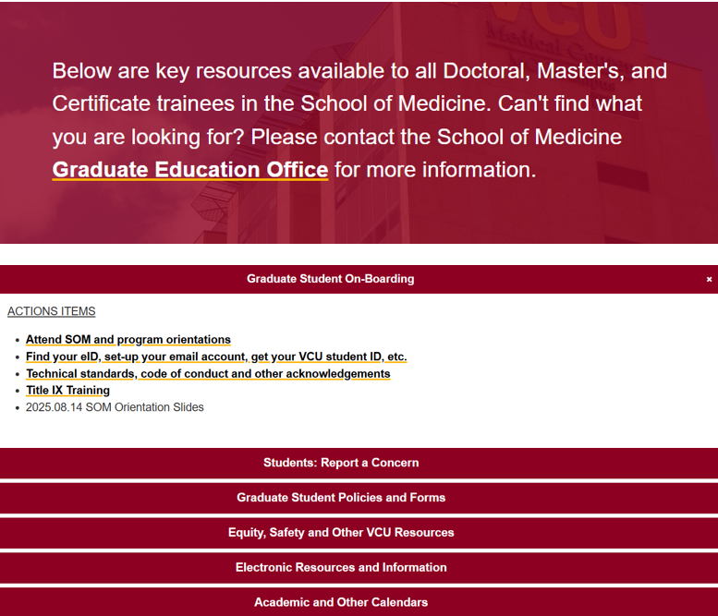
https://medschool.vcu.edu/education/graduate/current-students/
ACTION ITEMS
FOR STUDENTS
Before 8/18: meet with Program Directors, register for classes
By 8/18: initiate training ☺

Slide 12
ADVANCED DEGREE ORIENTATION
Debbie Roberts, M.Ed.
Division for Academic Success
Assistant Director
Virginia Commonwealth University

Slide 13
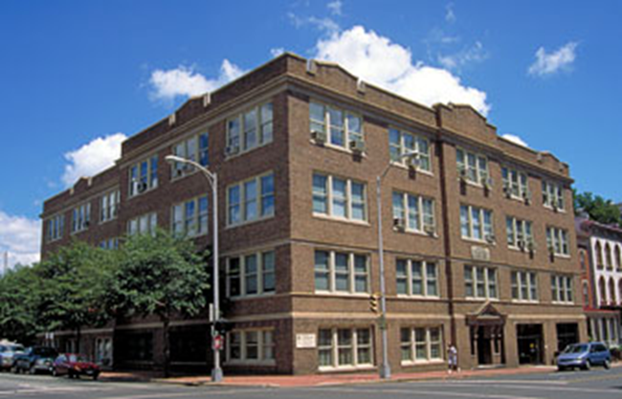
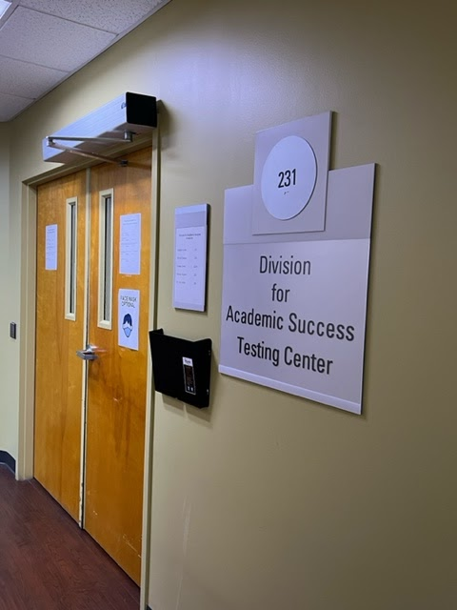
Division of Academic Success
The Division for Academic Success (DAS) offers disability and academic support services to students in the VCU Health Sciences schools.

Slide 14
Academic Accommodations
A student with an ADA qualifying disability or condition has the right to request reasonable academic accommodations.
Accommodations are granted to students who have a documented disability
Accommodations allow students access to demonstrate their knowledge of the content of the curriculum
Accommodations do not compromise the technical standards of the program

Slide 15
Academic Support Services
(available for every student)
Study Skills
Exam/Test-taking Skills
Note-taking Skills
Time Management Strategies
Learning Connection Inventory
das.vcu.edu
acadsuccess@vcu.edu

Slide 16
ADVANCED DEGREE ORIENTATION
Eva Melendez, Ph.D.
Senior Staff Clinician
University Counseling Services
Virginia Commonwealth University

Slide 17

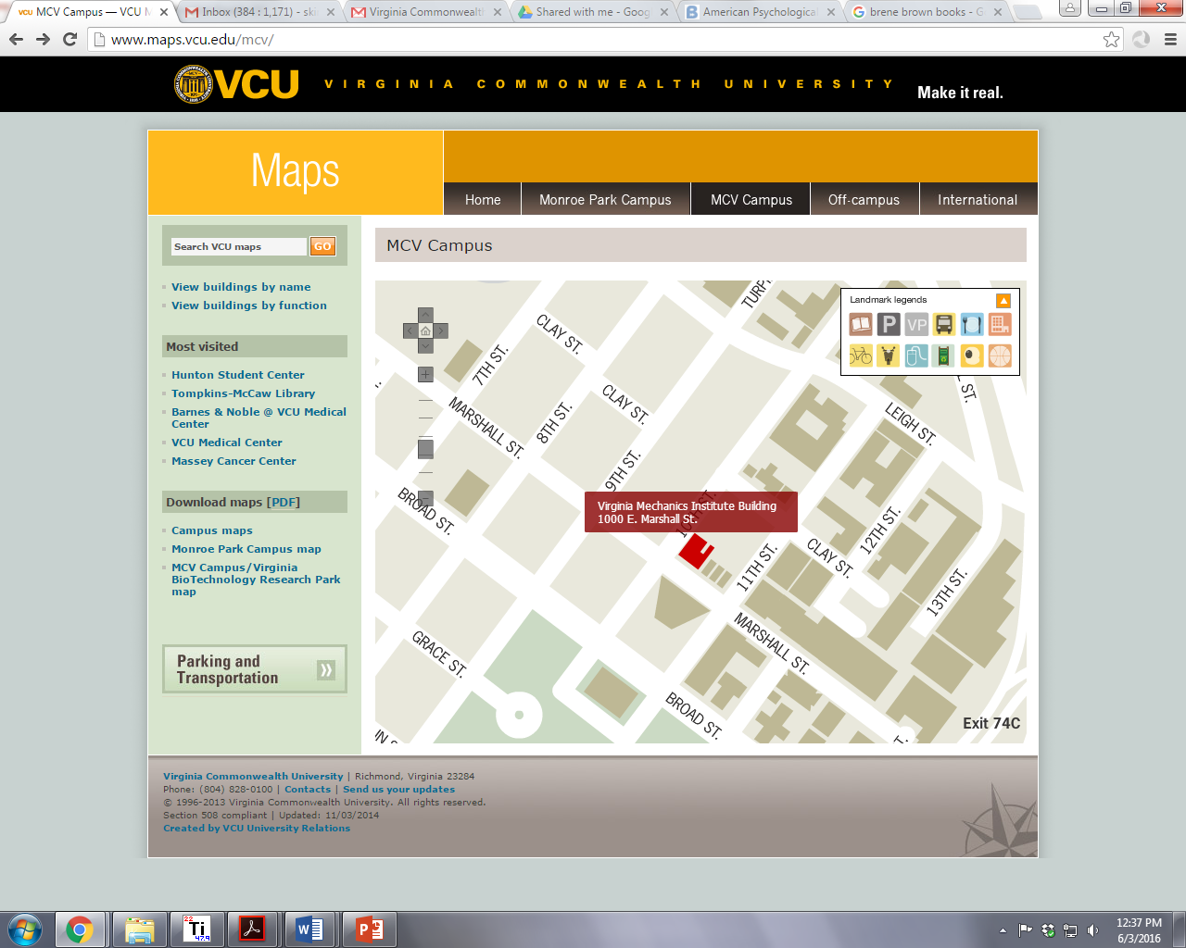
Website: https://counseling.vcu.edu/
Phone number:
(804) 828-6200
Mon 10am-7pm
Tue,Thu, Fri 8am-5pm
Wed 11:30am-5pm
Crisis: 24hr/day
Notes:
Liaison role - we all work with dentistry

Slide 18
Outreach
Crisis Services
Clinical Services
Confidentiality - few exceptions - not shared with the school
Survivor Support Services
Rams in Recovery
Notes:
Exceptions to confidentiality include risk to self or others, current abuse of child or vulnerable adult, or if records are subpoenaed

Slide 19


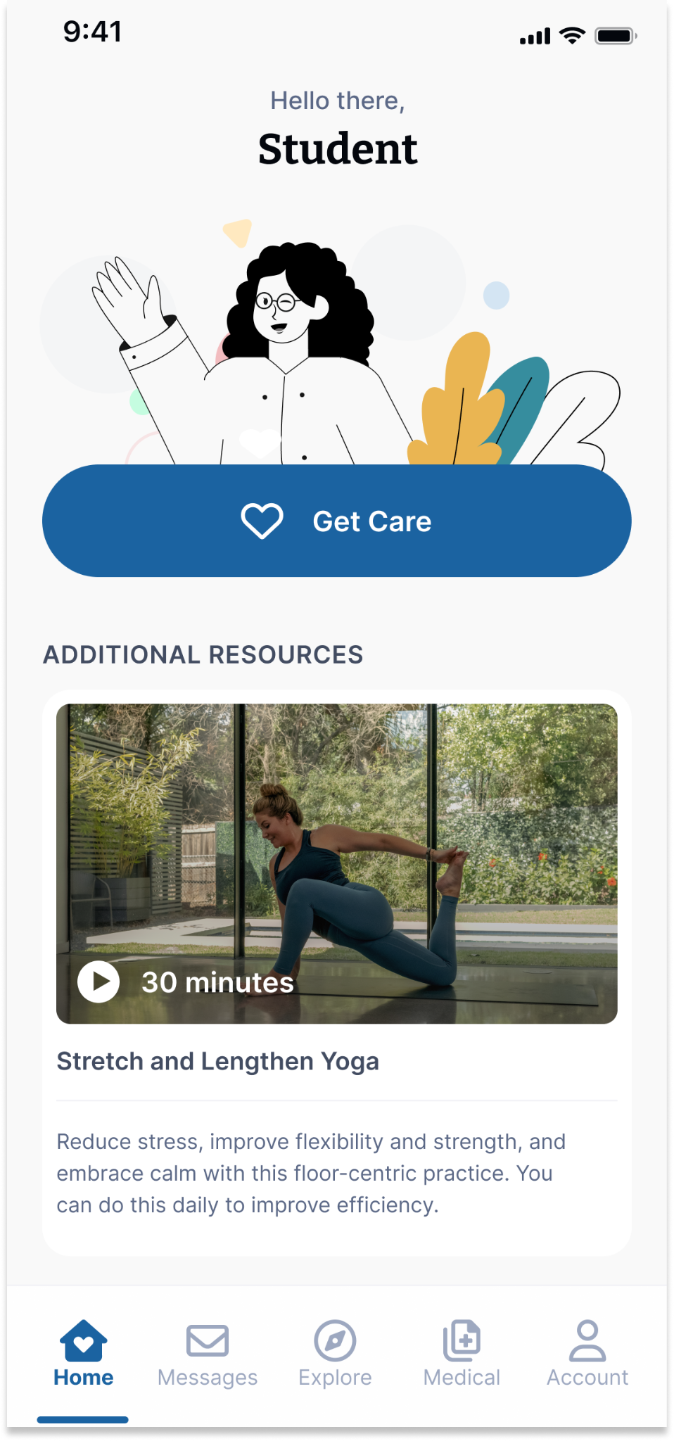




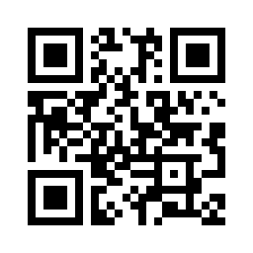



Your Virtual Health and Well-Being Resources
Available on the TimelyCare app or timelycare.com/vcu
Health Coaching
Use this to help develop healthy lifestyle behaviors.
TalkNow
24/7, on-demand emotional support to talk about anything.
Self-Care Content
Visit the “Explore” page for guided self-care content.
Scheduled Counseling
Choose your preferred day, time, and mental health provider.
Scan the QR Code to access care.
@timelycare
QR CODE HERE
It’s for Students.
@timelycare
FOR FREE.
@timely_care

Slide 20
ADVANCED DEGREE ORIENTATION
Anita Navarro, EdD, moderator
Student Panel “What to Expect in Graduate School”
Jean Patrick Gonzales, PhD Biochemistry
Kendal Madar, PreMed CERT
Parker Phillips, MS Genetic Counseling
Jadon Porch, PhD Human Genetics
Isabella Steiner, PreMed CERT

Slide 21
ADVANCED DEGREE ORIENTATION
Gilbert Glago, PhD Microbiology & Immunology
Graduate Student Leadership Council
Sachin Kumar Kempelingaiah, PhD Biochemistry
International Student Group
Shelbey Strandberg, PhD Neuroscience
Women in Science
Jess Bell, PhD Human Genetics
CMGM Graduate Student Group

Slide 22


Graduate Student Leadership Council(GSLC)
WHO ARE WE?
The Graduate Student Leadership Council (GSLC) is a student-led initiative composed of representatives from each biomedical research department at VCU School of Medicine.
GSLC was created to:
  Empower students to advocate for academic, professional, and personal development needs
  Serve as a bridge between graduate students and the SOM Office of Graduate Education
  Collaborate with faculty to enhance the overall student experience
What Has GSLC Done So Far?
  Mentorship Evaluation and Advocacy
    Assess the quality of mentorship students receive from their primary advisors.
  Mentee Self-Assessment Survey
    Understand how students view their own roles in the mentor-mentee relationship

Slide 23
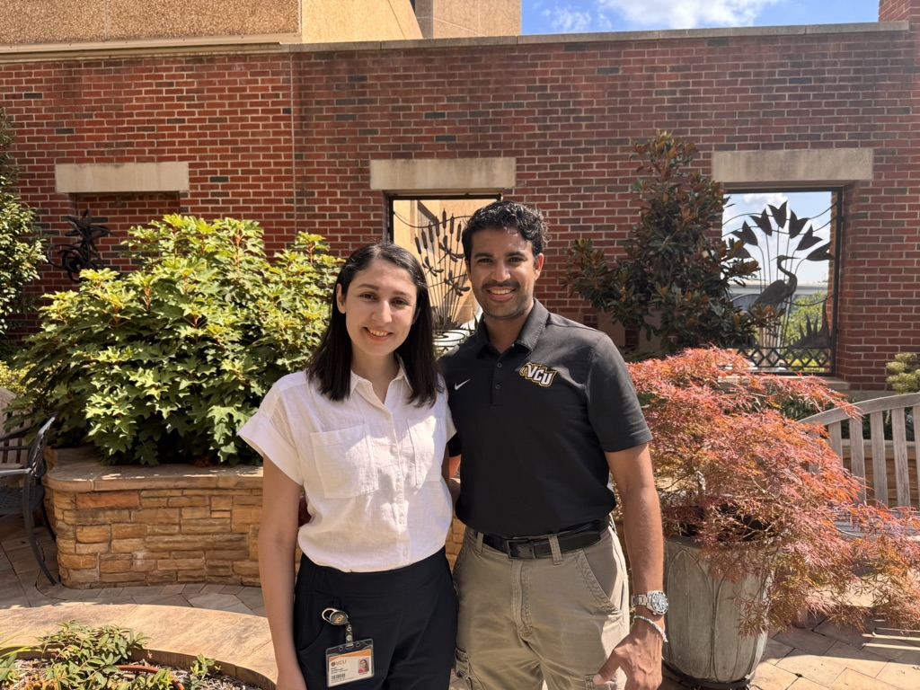
VCU School of Medicine International Student Group (SOMIS)
President (RIGHT): Sachin Kumar Kempelingaiah
  1st Year Ph.D. CMGM Department (Biochemistry)
    Mentor: Dr. Can Senkal
Vice President (LEFT): Negin Zia Miavaghi
  3rd Year Ph.D. CMGM Department (Biochemistry)
    Mentor: Dr. Kaustubh Datta

Slide 24
VCU School of Medicine International Student Group (SOMIS)
GOALS:
  Create a welcoming environment for current and incoming international students.
  Provide a tentative blueprint for students living in the United States on an F-1 visa.
  Enhance collaborations within departments of the School of Medicine.
Who can join?
  International Ph.D. students
  Post Docs
  Anyone who’s interested in being part of a cultural and diverse community

Slide 25
THANK YOU
kumarkempelsg@vcu.edu
ziamiavaghn@vcu.edu

Slide 26
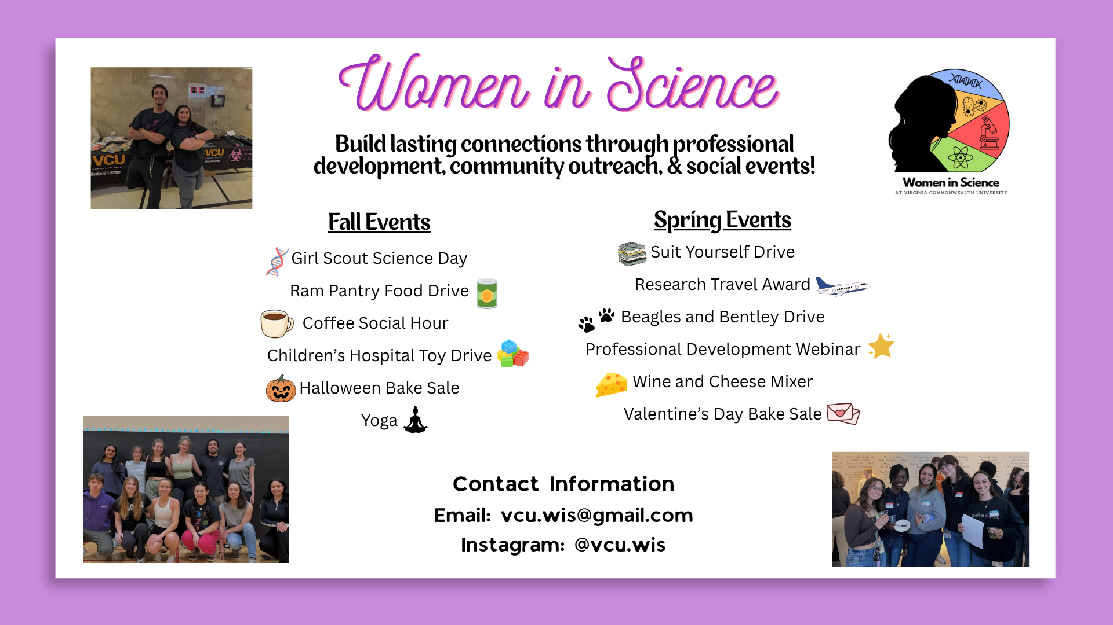

Slide 27
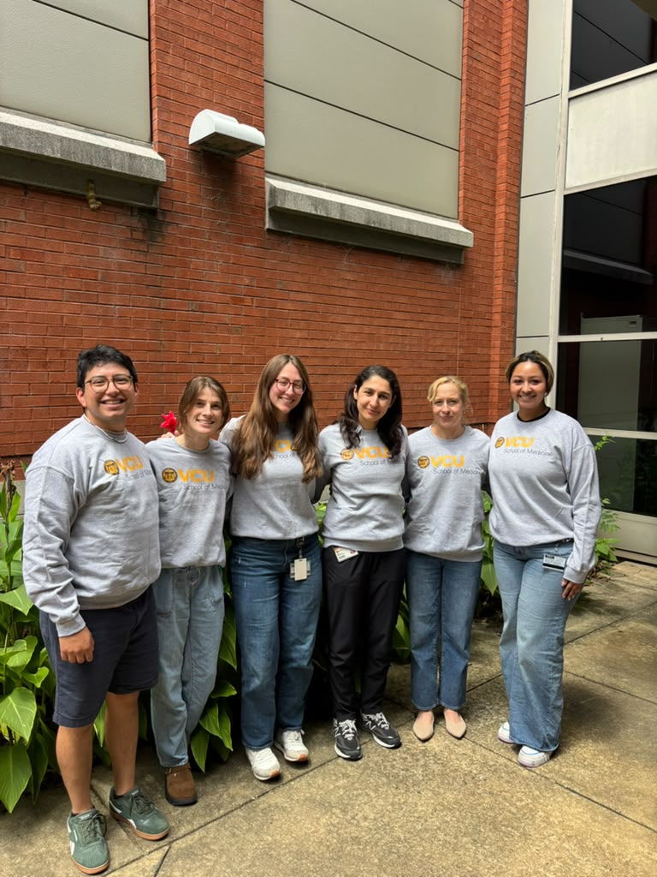
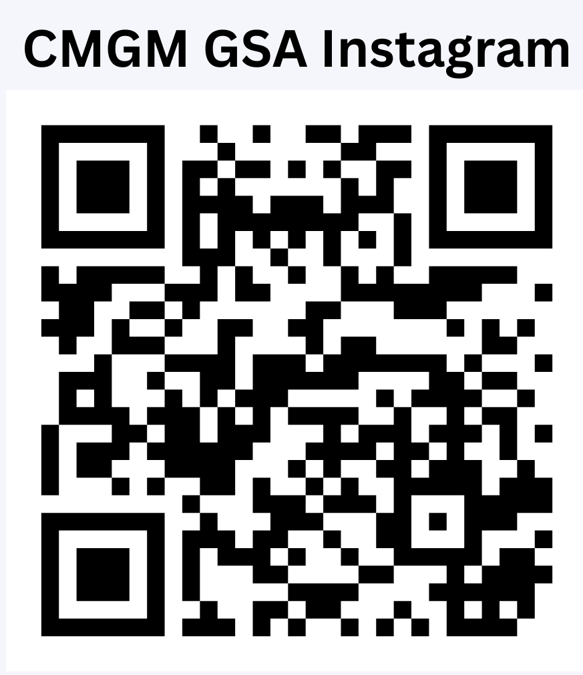
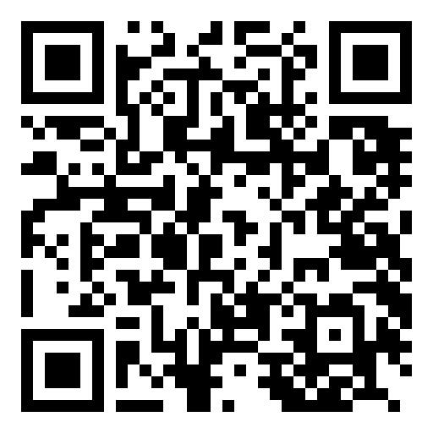
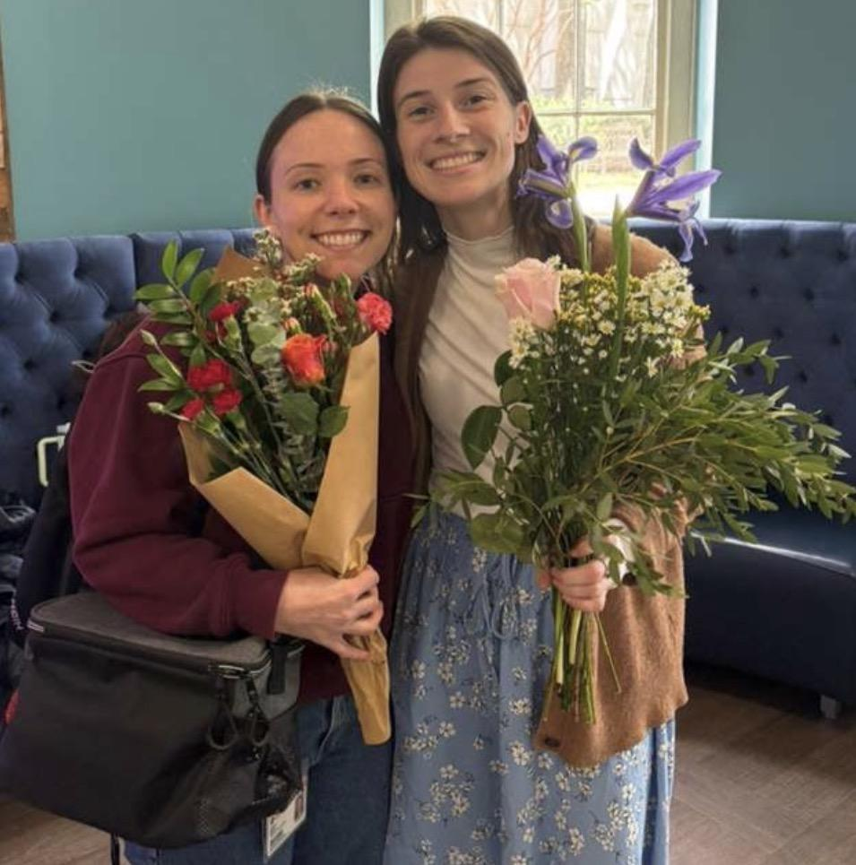
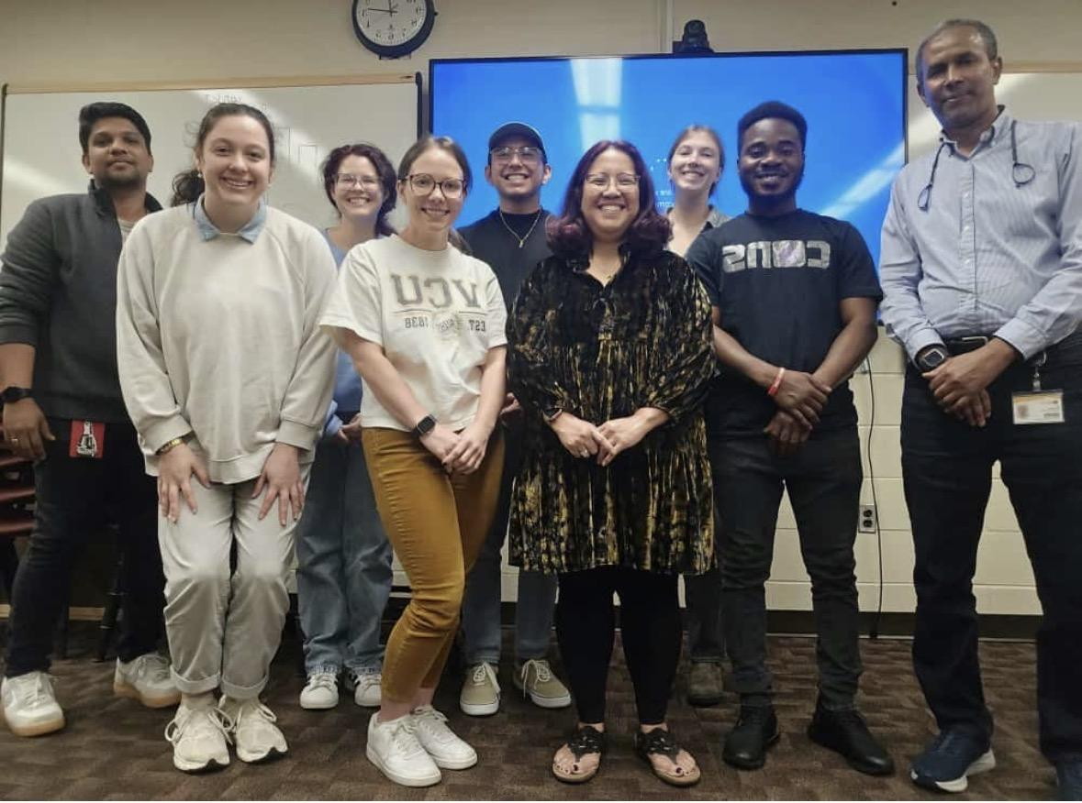
First Meeting:
August 21st, 12:30 PM
Sanger Hall, room 8-036
Department of Cellular, Molecular, and Genetic Medicine
Ramsconnect
Graduate Student Association
The CMGM Graduate Student Association is dedicated to fostering a strong, inclusive community through collaboration, support, and continuous learning. We aim to connect students across disciplines by providing opportunities for networking, professional development, and community outreach. Through academic resources, social events, and peer engagement, we strive to enrich the graduate student experience and empower one another both personally and professionally.

Slide 28
ADVANCED DEGREE ORIENTATION
Mike Grotewiel, Ph.D.
Senior Associate Dean for Graduate Education
School of Medicine
Virginia Commonwealth University

Slide 29
QUESTIONS AND ANSWERS
Only 3 answers!
Contact my program director
or course director!
Very, very important!
YES!

Slide 30
QUESTIONS AND ANSWERS
You are confused about course registration. What should you do?
How important is that?
Will they help you?
Contact my program director
or course director!
Very, very important!
YES!

Slide 31
QUESTIONS AND ANSWERS
You struggled with an assignment. What should you do?
How important is that?
Will they help you?
Contact my program director
or course director!
Very, very important!
YES!

Slide 32
QUESTIONS AND ANSWERS
You have a question about resources that might be available. What should you do?
How important is that?
Will they help you?
Contact my program director
or course director!
Very, very important!
YES!

Slide 33

QUESTIONS?

